Slide 1



Every Child is Special
LEXආයුධ
Personalized AI-Driven Rehabilitation for
Adolescents with
Dyslexia and Dyscalculia
Group ID: 24-25J-233

Slide 2
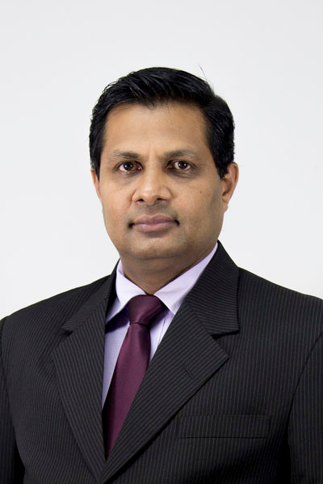
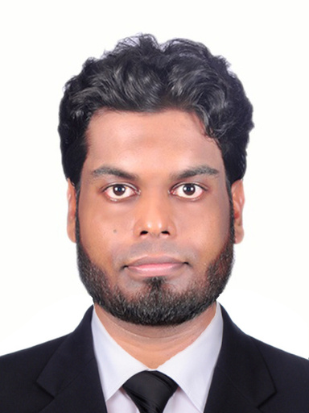

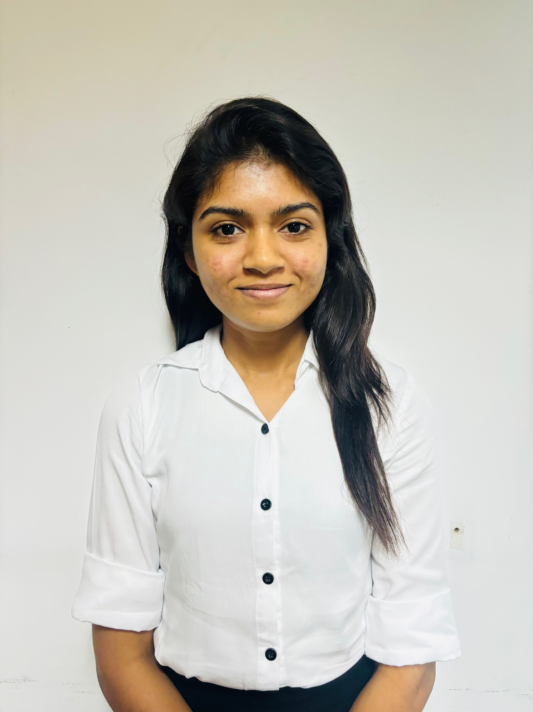
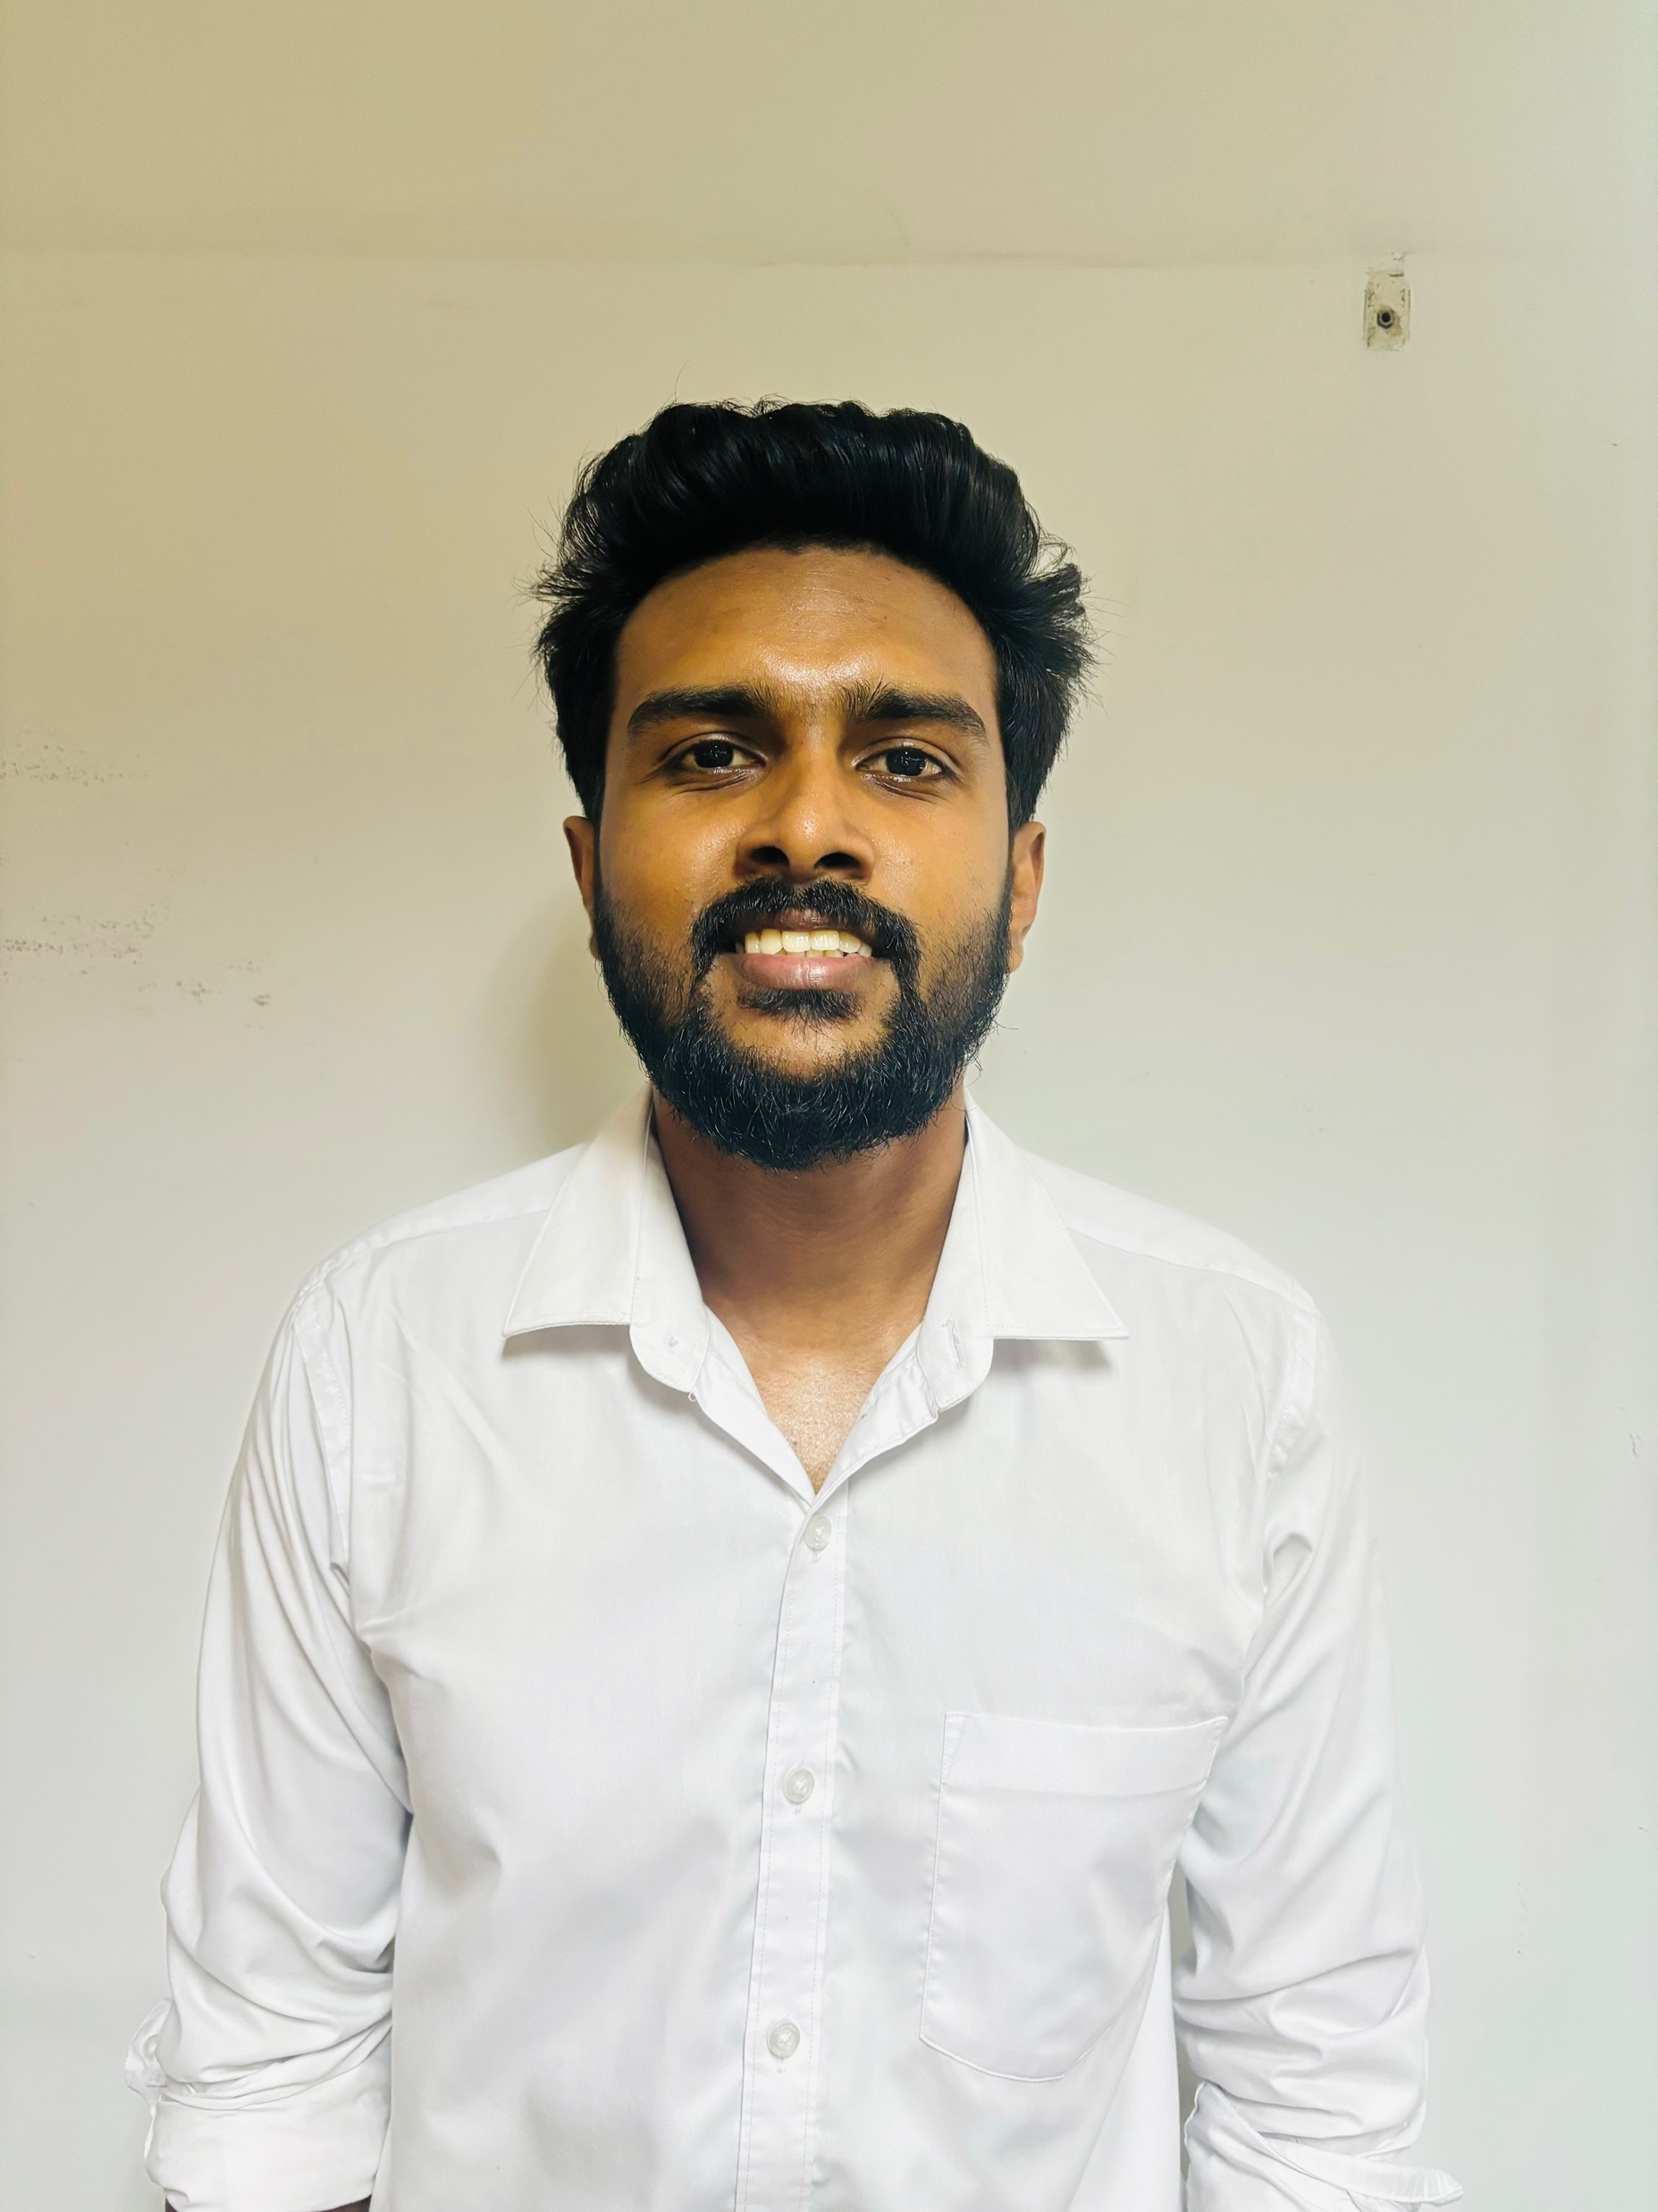
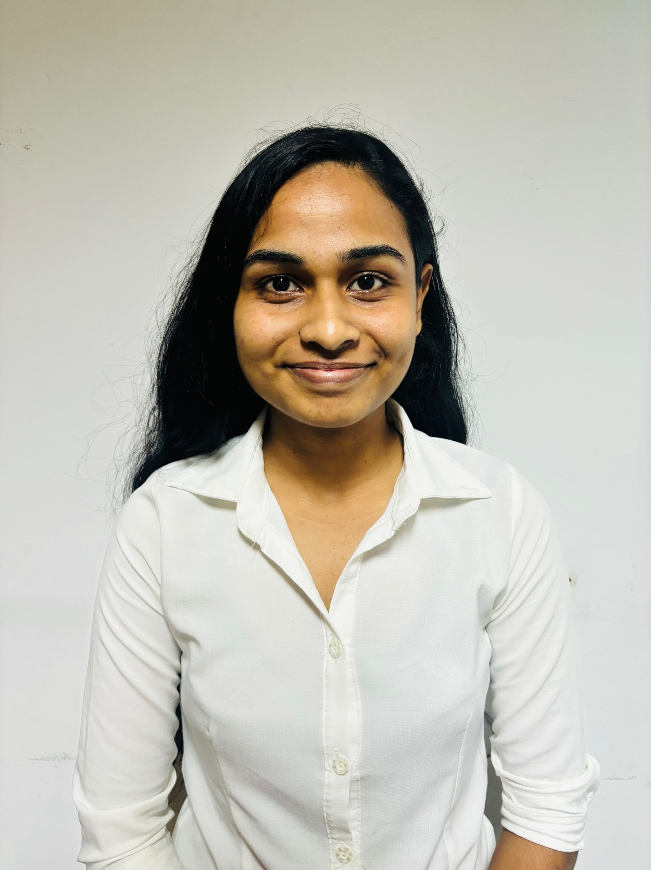
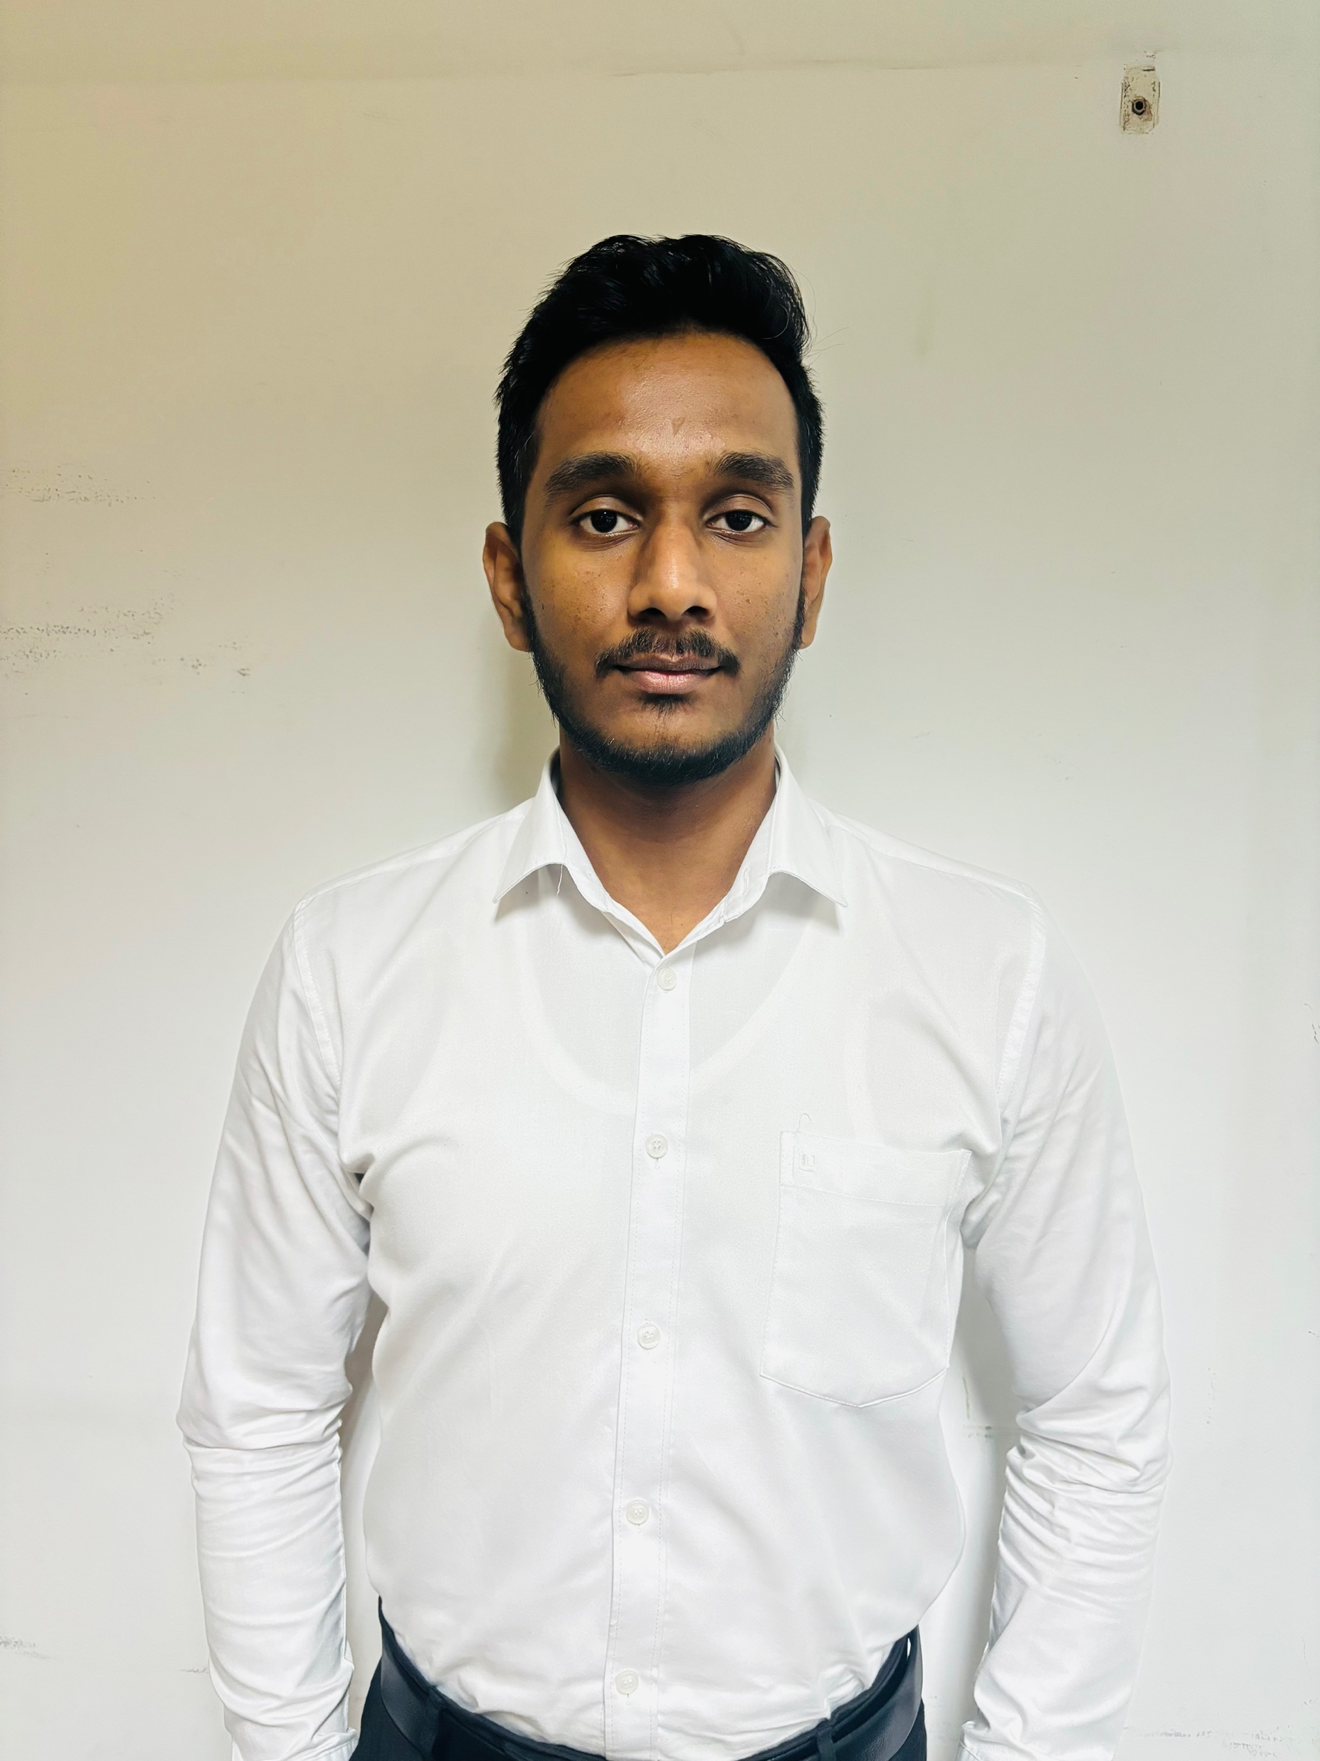
OUR TEAM
Prof. Samantha Thelijjagoda
Supervisor
Dr. Junius Anjana
Co - Supervisor
Dr Asiri Hewamalage
External Supervisor
Silva T.U.D
IT21318320
Madusanka G.K.I
IT21189944
Thalangama T.P
IT21223594
Dissanayake M.G.T.W
IT21319174

Slide 3
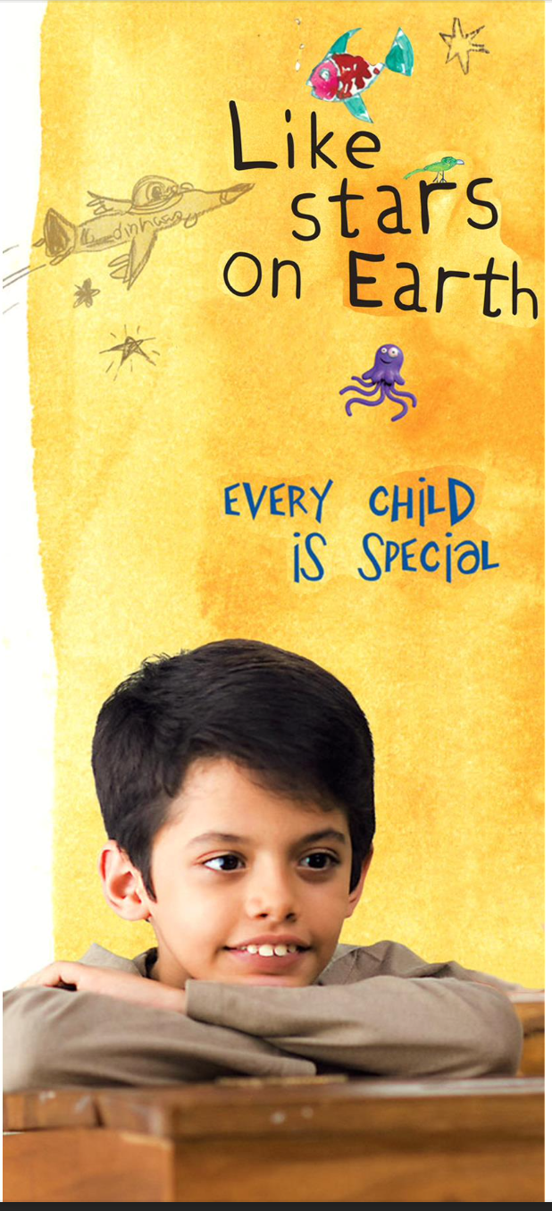
CONTENT
Introduction
2. Proven Gap and Solution
3. Prototype to Functional Units
4. Technical Expertise & Knowledge Application
5. Solution Implementation
6. Technology
7. Design
8. Project Completion
9. Budget

Slide 4
Introduction

Slide 5
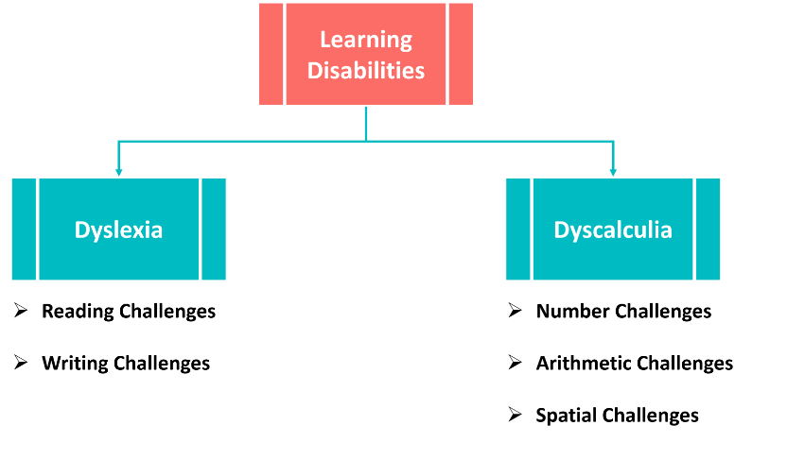
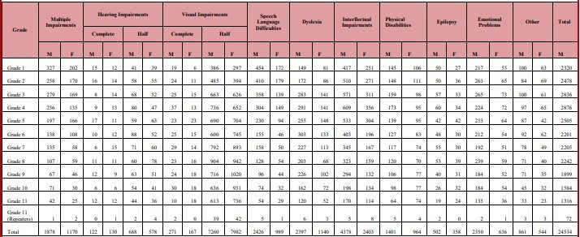
Disability among Students in General Class and Government Schools, Recorded in the Year 2019

Slide 6
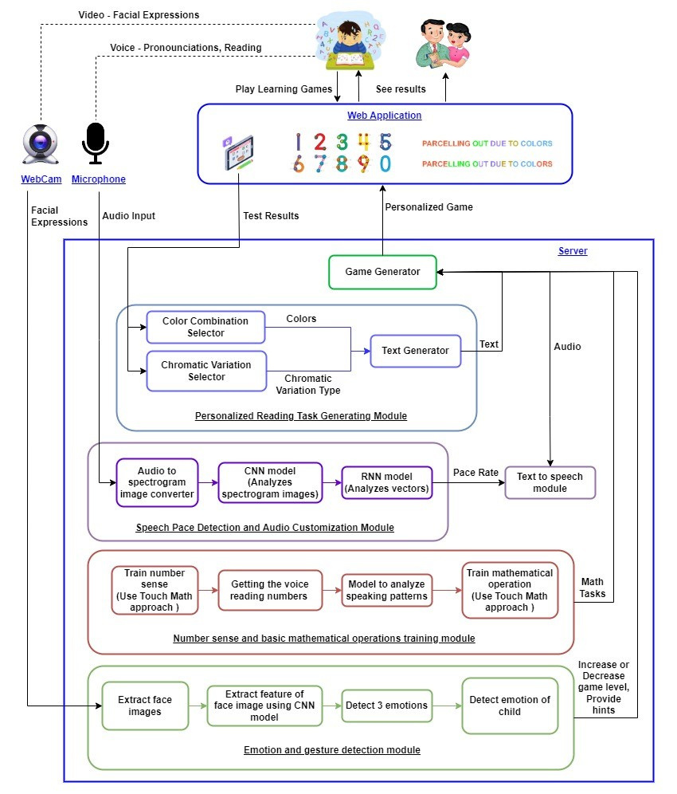

Slide 7
Proven Gap and The Solution
LexAyudha

Slide 8

Current Gaps
Lack of personalized capabilities
Fixed Color Themes
Fixed Font Types and Font Sizes
Fixed Speech Pace
Lack of emotional support.
Lack of utilizing multisensory and proven methodologies like TouchMath and Chromatic Variations.

Slide 9

Our Solution align with Objective
AI Driven real-time personalization
Chromatic Adjustments
Theme Adjustmemts
Speech pace Adjustments
Emotion Recognition
Adaptive Math Modules
Develop a personalized assistive learning platform for children with dyslexia and dyscalculia

Slide 10

Prototype to Functional Units
Modular Breakdown
Chromatic Variation Module: ASR + BERT (text adaptation)
Personalized Feedback through Emotion Analysis: Custom CNN model
Touch Math Integration: ASR + React.js for interactive math
Personalized Speech pace Module: Hybrid CNN-RNN model
Scalability
Cloud base MongoDB for data storage
Firebase storage bucket for media file storage
Microservice deployment using Docker and Kubernetes

Slide 11
Technical Expertise
and
Knowledge Application

Slide 12
Key Pillars of Consideration
Artificial Intelligence and Machine Learning
CNNs/RNNs: For emotion detection and speech pace prediction.
ASR: Text simplification and pronunciation feedback.
Multisensory Learning
Touch Math
Chromatic Adjustments

Slide 13
Technologies Applied
Tools/Frameworks
TensorFlow/PyTorch
React.js/Node.js (UI/backend)
MongoDB(data storage)
Algorithms
Hybrid CNN-RNN for speech pace
Xception for emotion classification

Slide 14
Solution Implemetation

Slide 15
Innovative Designs
Real-time Chromatic Adjustments
Gamified Touch Math
Emotion-driven support for learning
Speech-pace based audio adjustments

Slide 16
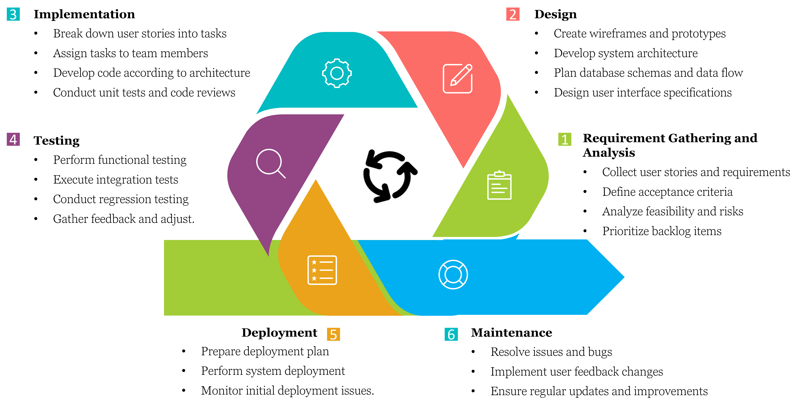
Software Development Life Cycle

Slide 17
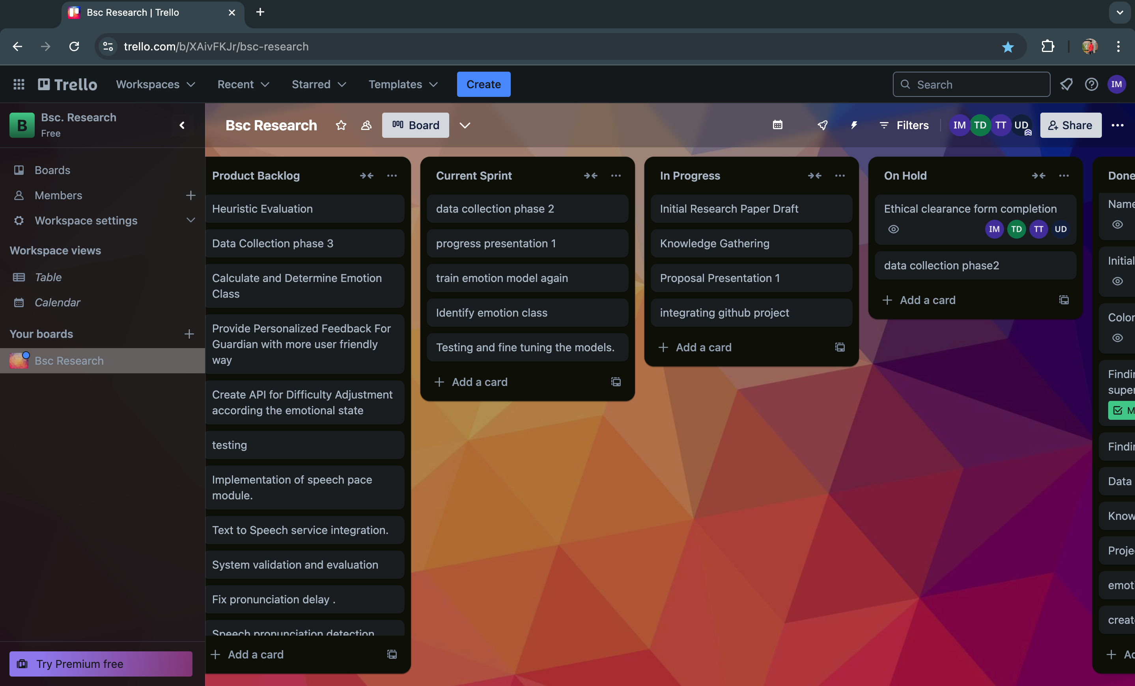

Project Management Dashboard
Figma Prototype

Slide 18
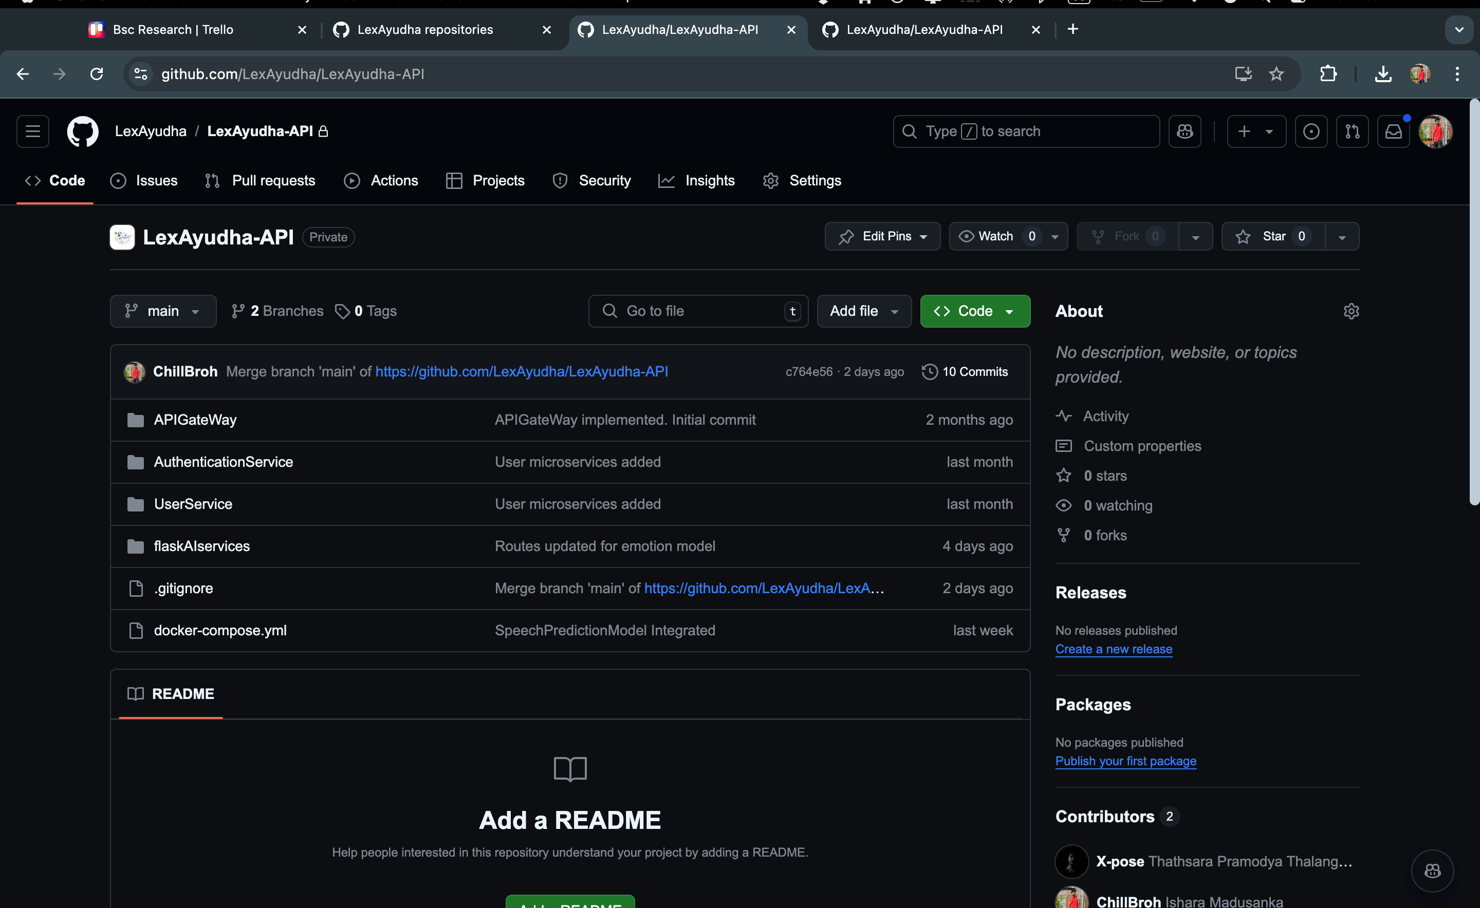
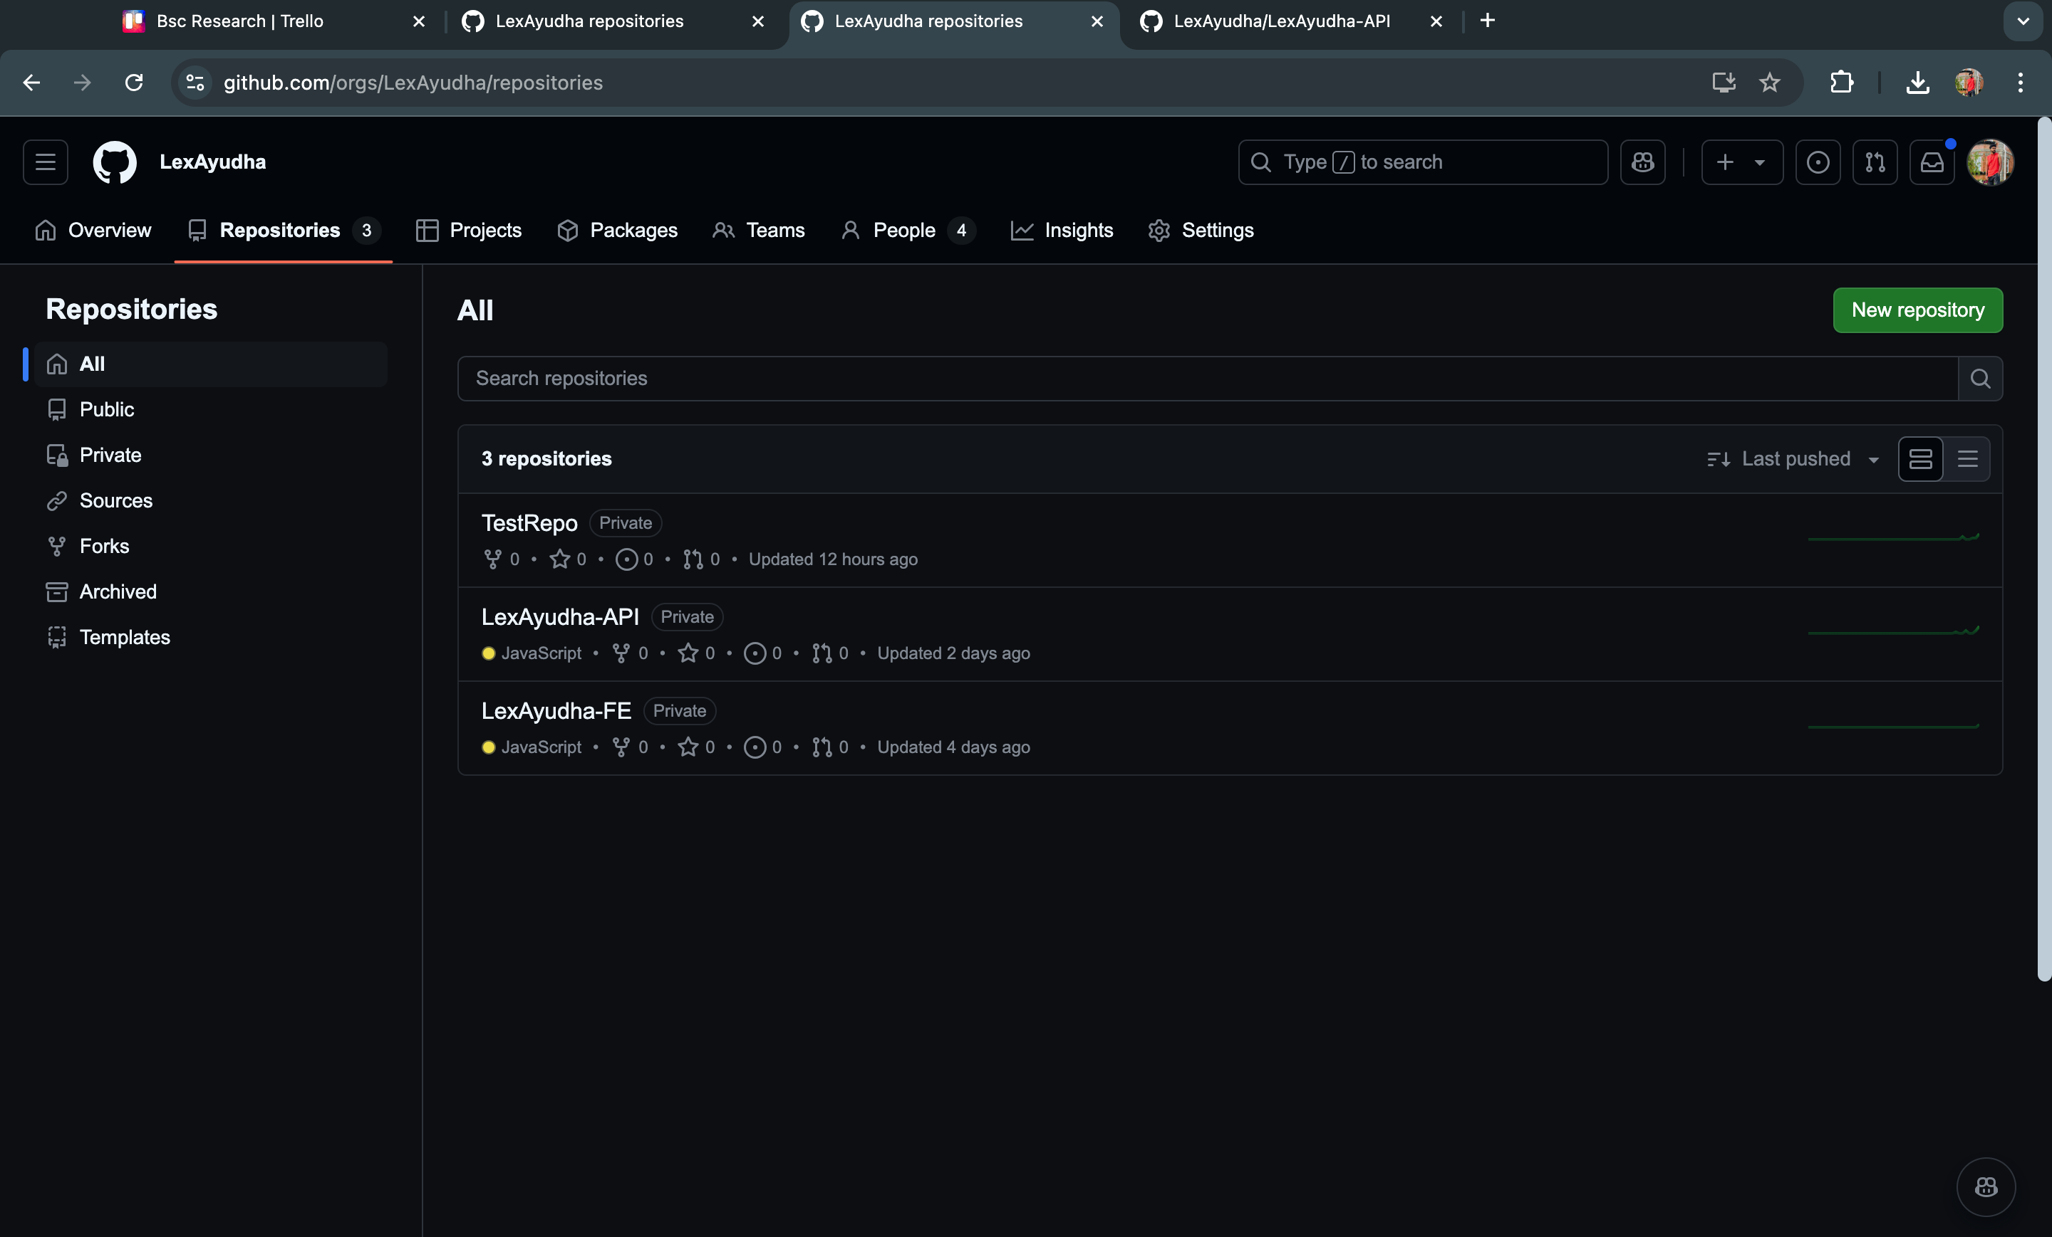
Version Control - Github

Slide 19
Standards/Best Practices
Coding Standards
Reusability of the components
Configurable settings
Ethical/Legal Considerations
Data privacy (encrypted user data)
Ethical clearance on Data collection
Attribution-free images

Slide 20
Non-Functional Requirements
Performance
Improvement in reading accuracy
Boost in math proficiency (Touch Math + ASR)

Slide 21
Completion

Slide 22
INDIVIDUAL COMPONENTS

Slide 23
IT21189944 | Madusanka G.K.I
BSc (Hons) Degree in Information Technology (specialization in Software Engineering)

Slide 24
EMOTION RECOGNITION TO PROVIDE REAL-TIME ADAPTIVE FEEDBACK AND ADJUST ACTIVITY DIFFICULTY
IT21189944 | Madusanka G.K.I | 24-25J-233

Slide 25
Research Problem
How do we create
A system that provide
Real time emotion detection to reduce stress level
Support student by dynamically changing the activity level
Personalized Feedback to guardian with child’s emotion status
IT21189944 | Madusanka G.K.I | 24-25J-233
Notes:
Learning disabilities like dyslexia and dyscalculia impact millions of students worldwide, the problem was current solutions only focus on improving their skill without considering their emotional state. So in my problem was how do we create a system to reduce the stress level of the student realtime while they are engaging with the activities and how do we inform their guardins about their improvements and emotional states.

Slide 26
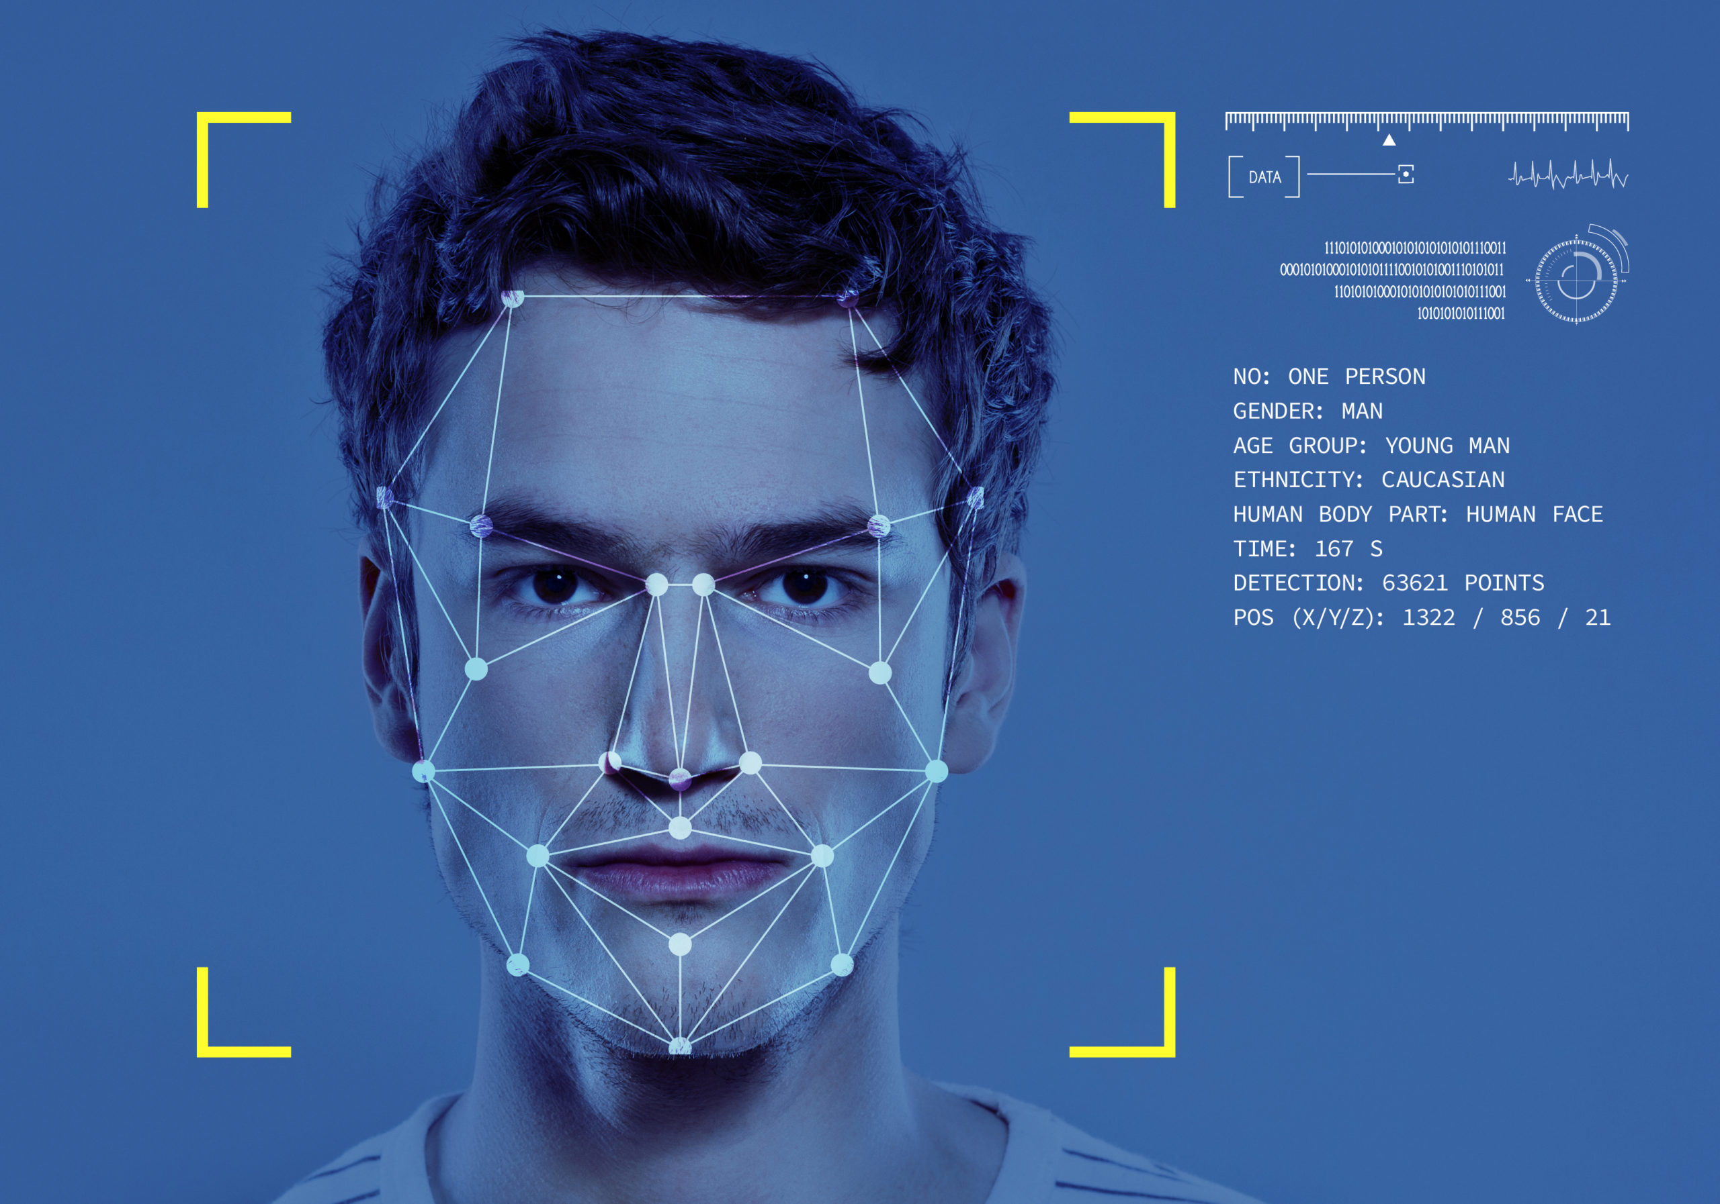
Solution
SPECIFIC OBJECTIVE
Emotion Recognition to provide real-time adaptive feedback and adjust activity difficulty level
SUB OBJECTIVES
Detect emotion and identify the emotion class
Dynamically change acitivity difficulty level
Keep track of student emotional records with relevet activity
Generate Personalized feedback for guardian
IT21189944 | Madusanka G.K.I | 24-25J-233
Notes:
Lexayudha, is a next generation designed to bridge this gap. By combining real-time facial emotion detection with adaptive learning technologies, we dynamically adjust task difficulty based on a student's emotions. Unlike traditional methods, Lexayudha not only focused on learning but also provides personalized emotional feedback reports for guardians, helping them to actively support their children’s educational journey

Slide 27

Objectives Cont.
Key Emotions (5):
1. Happiness
2. Sadness
3. Surprise
4. Anger
5. Neutral
Main Classes (3):
1. Distraction (extended period of neutral, surprise)
2. Frustration (sadness, anger)
3. Engagement (happiness, lower frequency of neutral/sadness
IT21189944 | Madusanka G.K.I | 24-25J-233

Slide 28
Requirements
System Requirements​
Stable internet connection.​
High Definition Web Cam
​
Personal Requirements ​
Consent to capture Video Data.​
Clear & Well lit environment.​
Software Requirements
Web browser with WebCam access.​ ​
Functional Requirements​
User Logs in to system.​
Capture Video Realtime.​
Recognize facial emotions
Dynamically change difficulty level
Generate Personalized feedback report
IT21189944 | Madusanka G.K.I | 24-25J-233

Slide 29
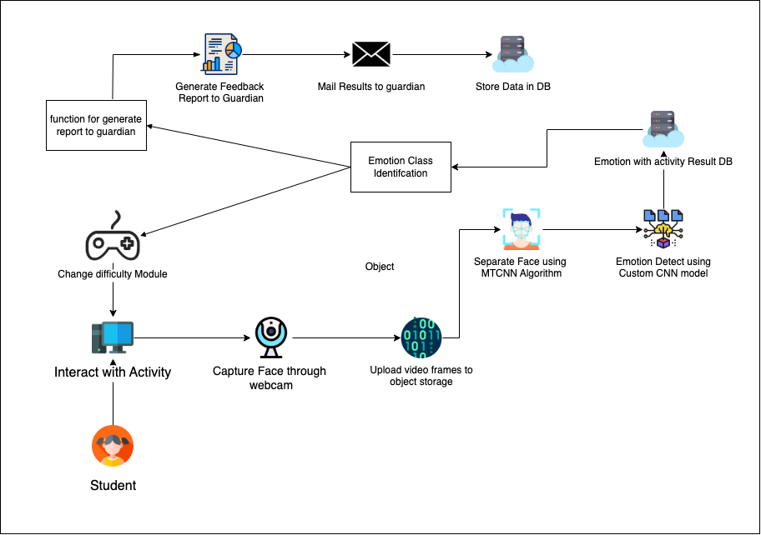
System Diagram
IT21189944 | Madusanka G.K.I | 24-25J-233

Slide 30
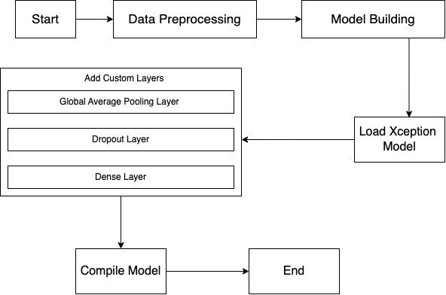
Flow Chart - Model
cross-entropy loss
Adam optimizer
IT21189944 | Madusanka G.K.I | 24-25J-233
Notes:
I start with Data Preprocessing, where the dataset of labeled emotion images is resized to 72x72 pixels and loaded in batches of 128 for efficient processing.
Next is Model Building, where we use the Xception architecture with pretrained ImageNet weights for transfer learning. This foundation is enhanced with layers for pooling, regularization, and a dense output to classify emotions into seven categories.The model is then trained using categorical cross-entropy loss and the Adam optimizer, with metrics like accuracy and precision ensuring performance evaluation

Slide 31
Risk Mitigation
Identified Risks & Mitigation Strategies
​
Poor model training caused by
unbalanced data.
Mitigate by mixing gathered training data
with Kaggle dataset.
​
Guardian Engagement with the
Feedback Report.
Mitigated by Simplify reports with clear visuals (e.g., pie charts)
​
Connect NodeJS User management
with flask backend
Mitigated by adding Microservice architecture
For backend
​
Data Security Concerns
Encrypt all data during transmission and
storage, ensuring compliance with privacy.
IT21223594 | Thalangama T.P. | 24-25J-233

Slide 32
Current Progress
Overall completion – 94% ​
 | Progress Presentation I | Progress Presentation II
Model implementation | 100% | 100%
Model training | 80% | 100%
Function to detect emotion class for given period of time | 60% | 100%
Keep track of student emotional records with relevant activity | 40% | 90%
Testing | 20% | 80%
IT21319174 | Dissanayake M.G.T.W | 24-25J-233

Slide 33
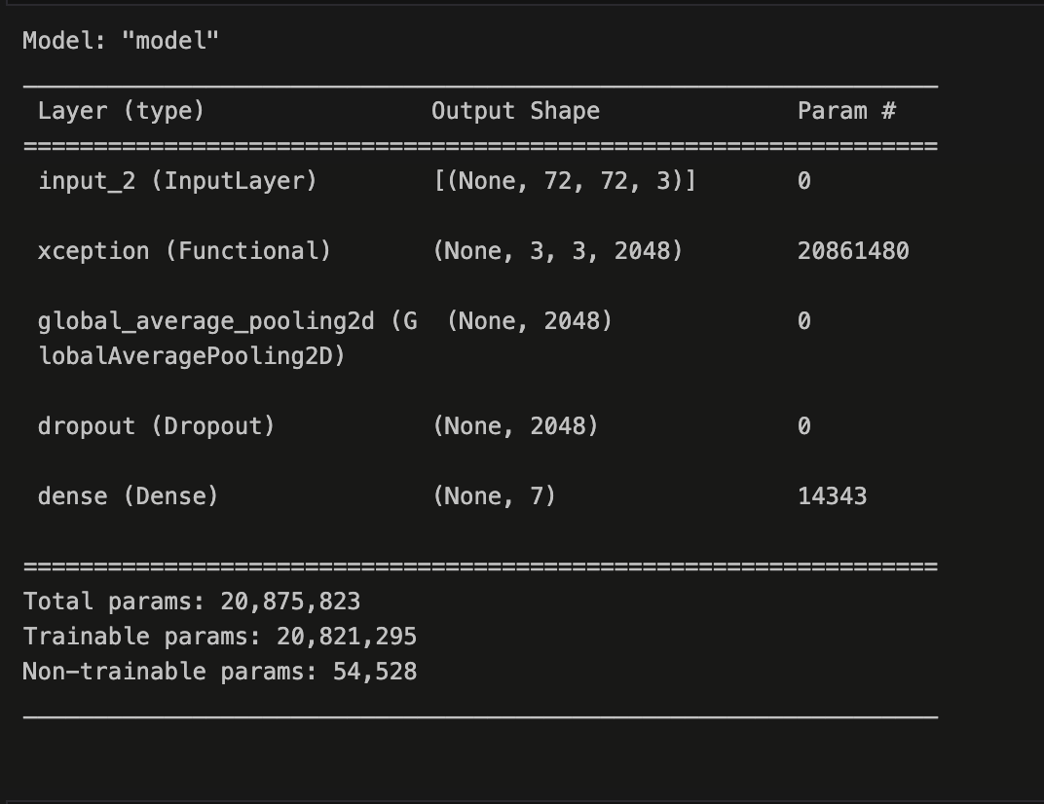
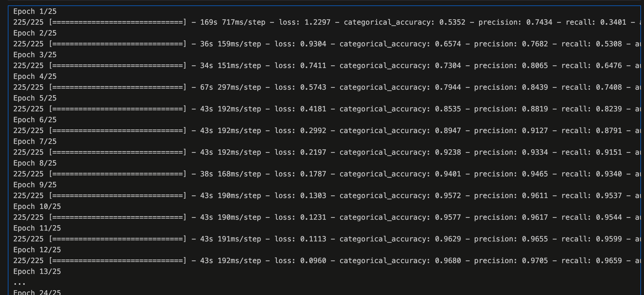
Evidence of Completion
Emotion Model Summary
IT21189944 | Madusanka G.K.I | 24-25J-233

Slide 34
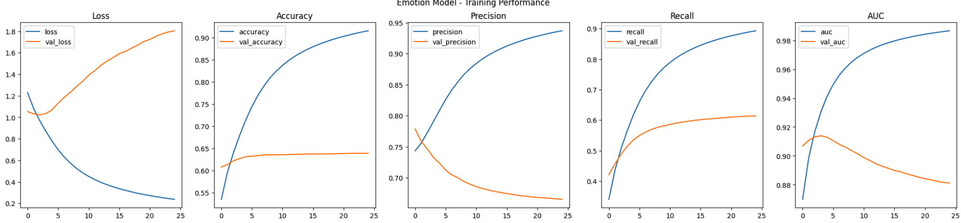
Evidence of Completion
Model Training Results Comparison
Training and validation loss over epochs
IT21189944 | Madusanka G.K.I | 24-25J-233

Slide 35
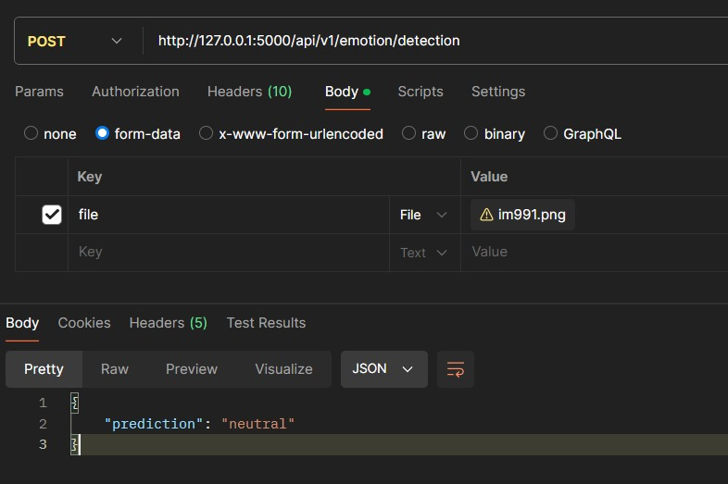
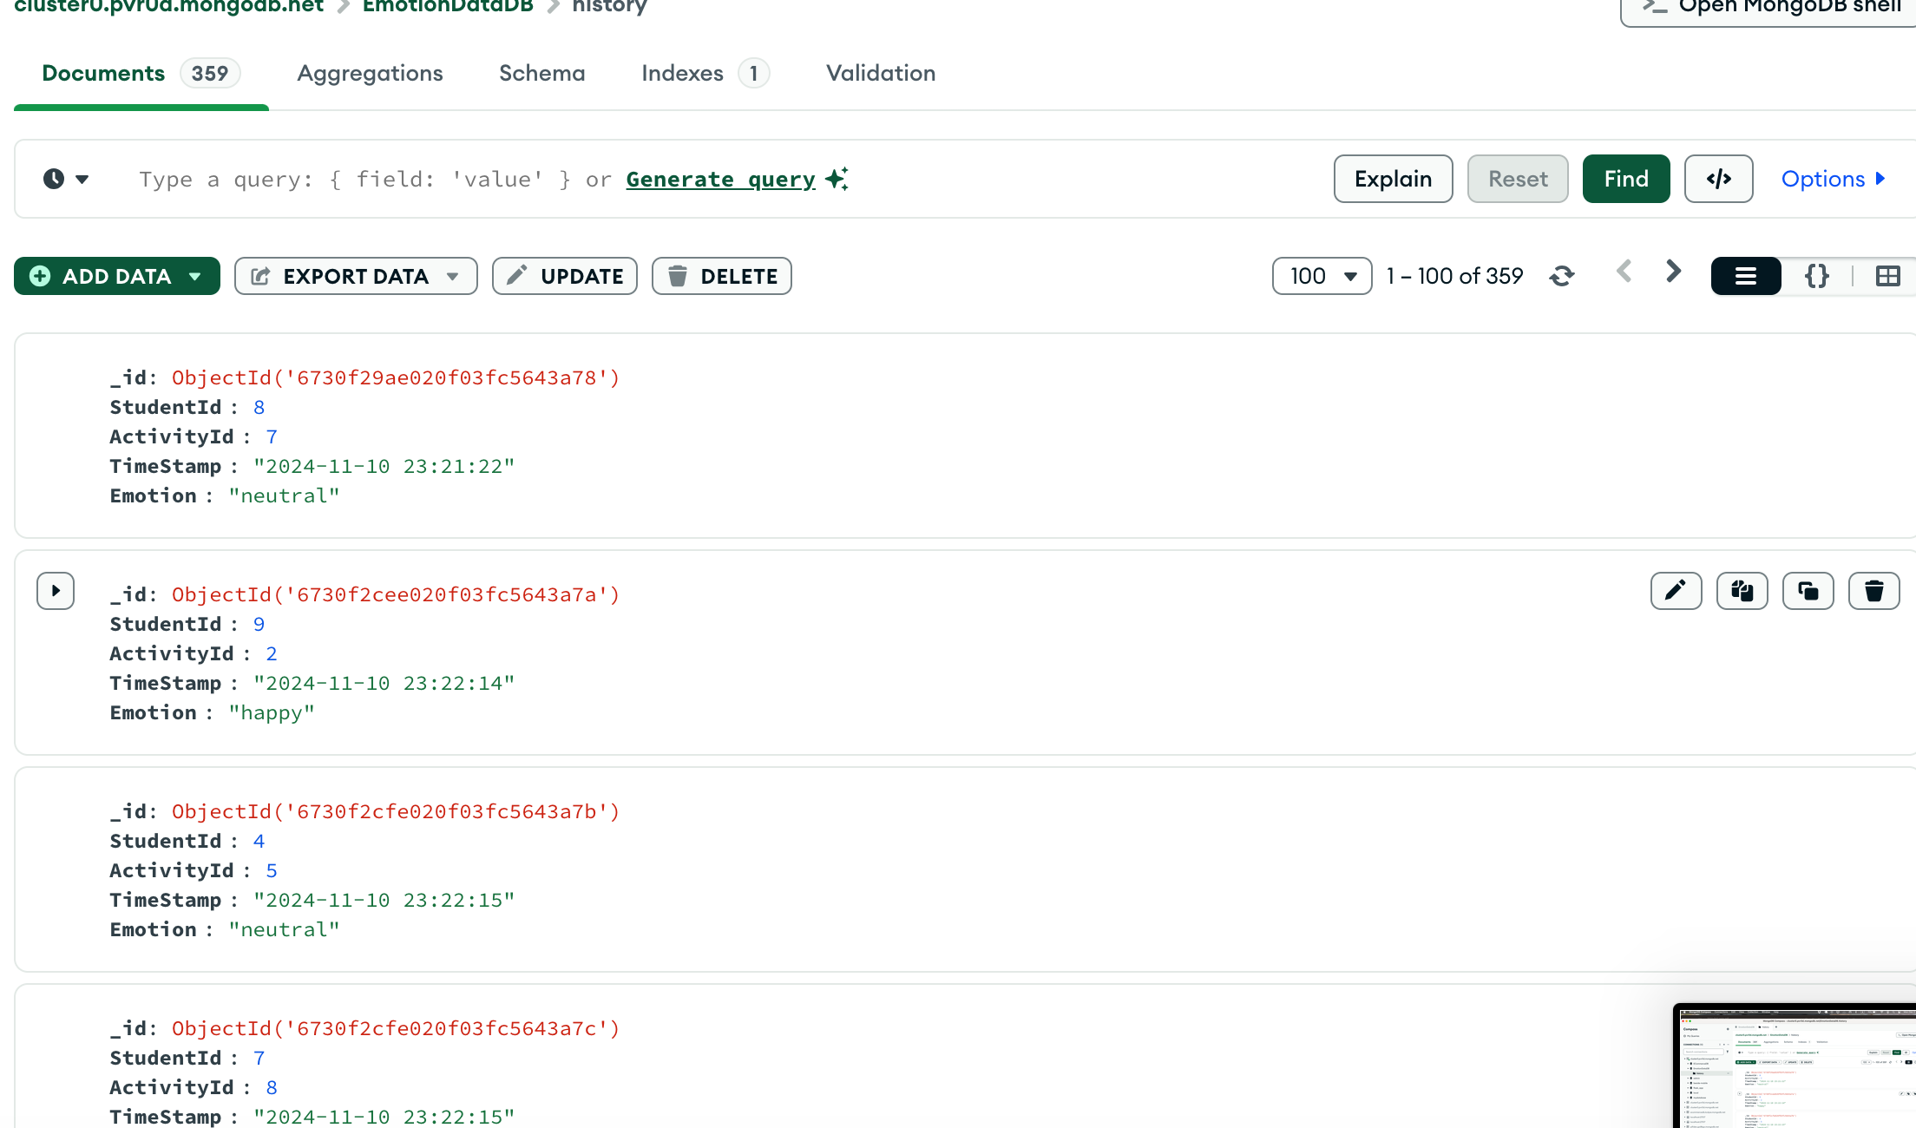
Evidence of Completion
API Request and Face Detected Mongo DB results
IT21189944 | Madusanka G.K.I | 24-25J-233

Slide 36
IT21319174 |Dissanayake M.G.T.W
BSc (Hons) Degree in Information Technology (specialization in Software Engineering)

Slide 37
TOUCH MATH APPROACH FOR ENHANCING NUMBER SENSE AND MATHEMATICAL OPERATIONS
IT21319174 | Dissanayake M.G.T.W | 24-25J-233

Slide 38
Background
For Dyscalculic adolescents,​
Hard to identify numbers.
Memorable and auditory learning is precious.
IT21319174 | Dissanayake M.G.T.W | 24-25J-233

Slide 39

Research Problem
Lack Analytical Skills
Insufficiency of Traditional Methods
Need Alternative Approches
Need more personalized study process
IT21319174 | Dissanayake M.G.T.W | 24-25J-233

Slide 40
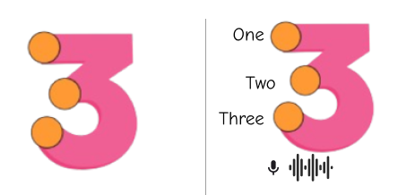
Objectives
NOVELTY OBJECTIVE
Implement teaching numbers with text-to-speech feature.
Integrate voice recognition to analyze number pronunction
OTHER SUB OBJECTIVES
Providing practice sessions, utilizing touch mach approach
Providing mathematical operations utilizing touch mach approach​
Generate performance report
IT21319174 | Dissanayake M.G.T.W | 24-25J-233

Slide 41
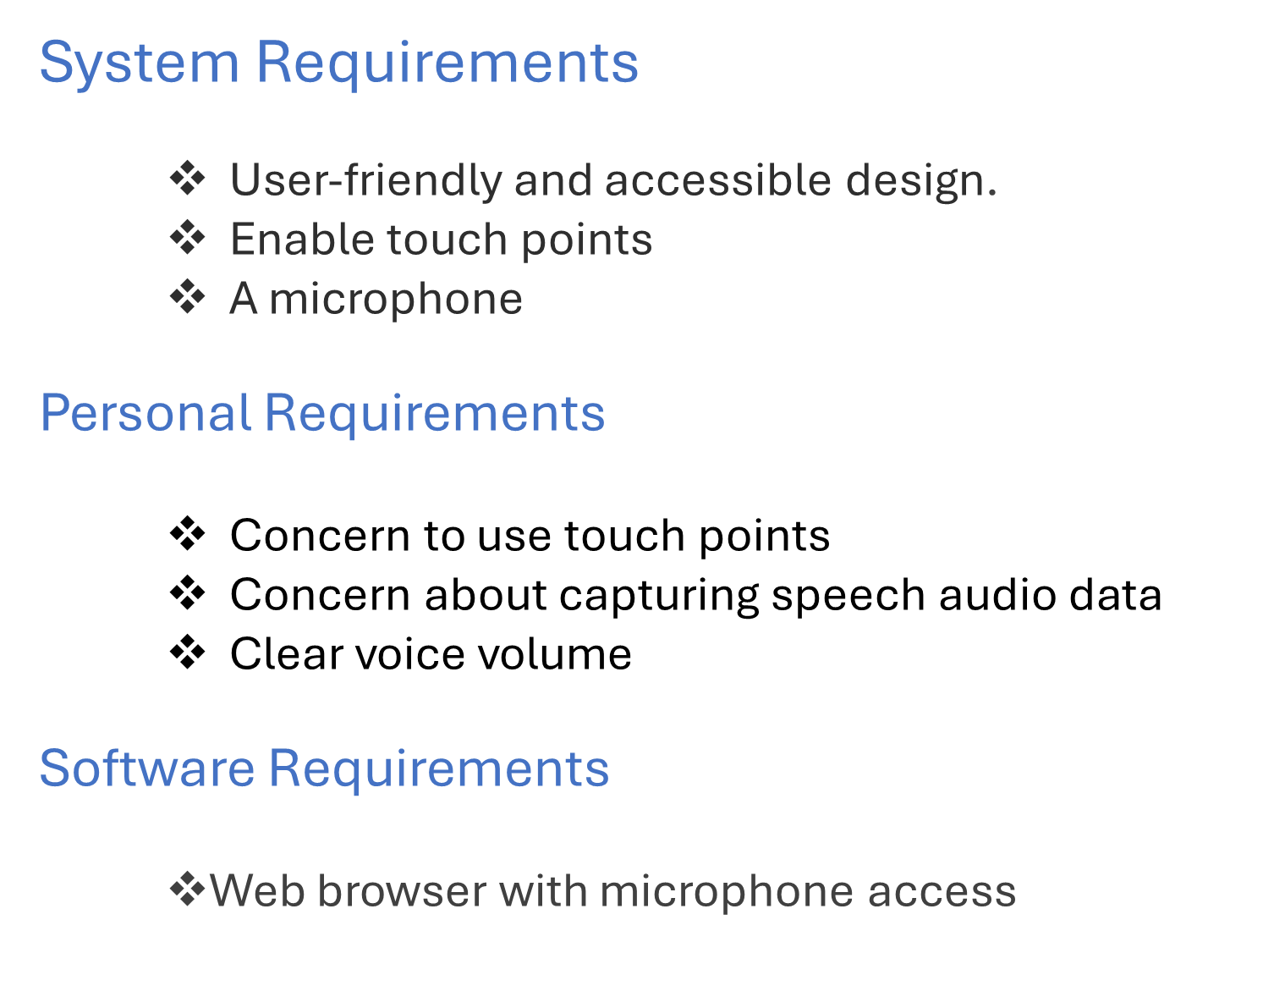
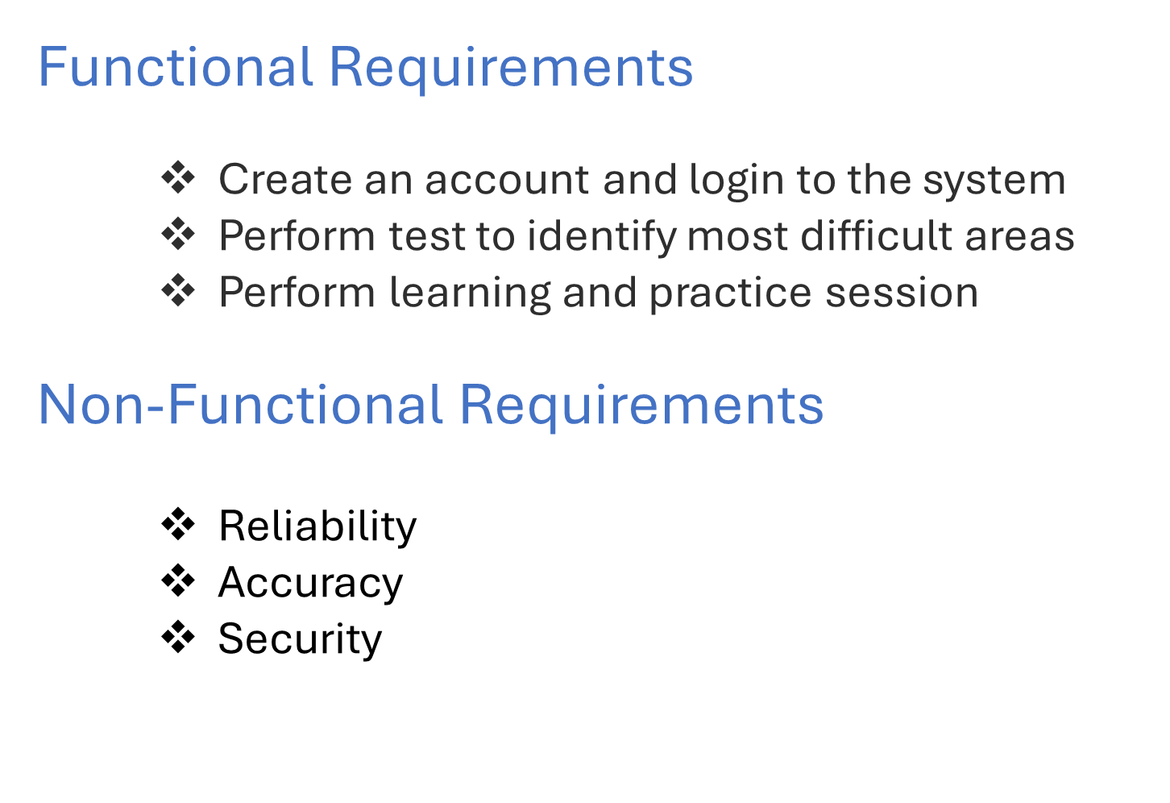
Requirements
IT21319174 | Dissanayake M.G.T.W | 24-25J-233

Slide 42
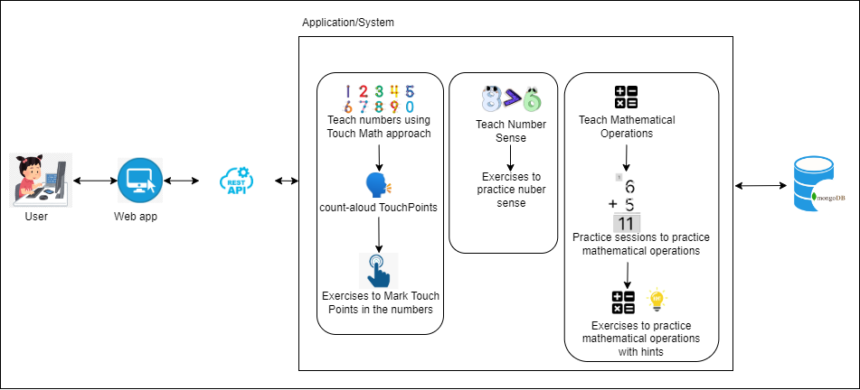
Methodology
IT21319174 | Dissanayake M.G.T.W | 24-25J-233

Slide 43
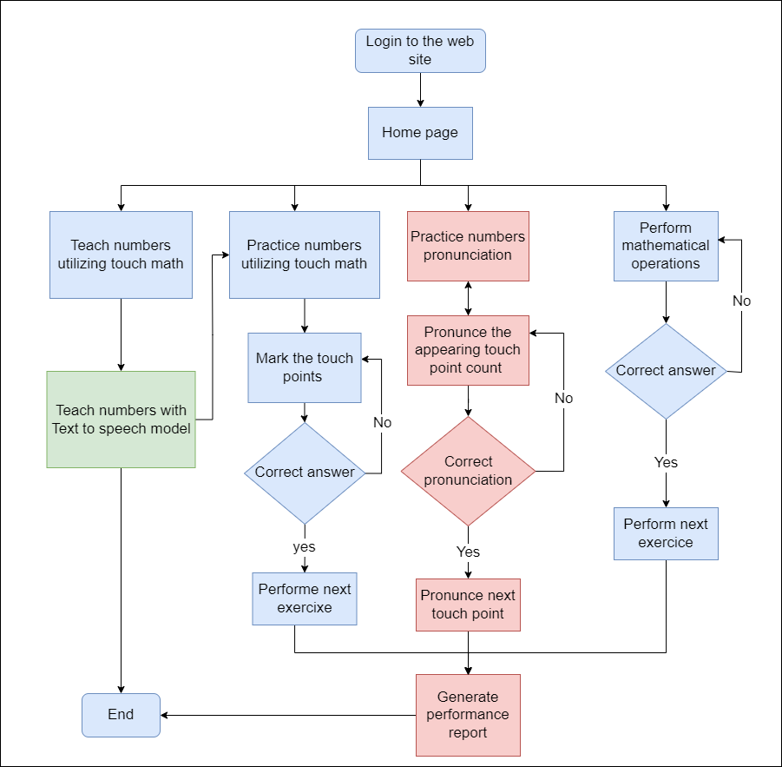
Flow Chart
IT21319174 | Dissanayake M.G.T.W | 24-25J-233

Slide 44
Current Progress
Overall completion – 96% ​
 | Progress Presentation I | Progress Presentation II
Rendering interactive touch points for numbers | 100% | 100%
Allowing users to practice touch point interactions for number learning | 100% | 100%
Implementing using Web Speech API | 80% | 100%
Rendering interactive touch points for operations | 100% | 100%
Generating random numbers | 100% | 100%
Integrate voice recognition to analyze number pronunction | 40% | 90%
Number Sense | 40% | 100%
Testing | 20% | 80%
IT21319174 | Dissanayake M.G.T.W | 24-25J-233

Slide 45
Evidence of Completion
Teaching process
Addition Operations
Practice Sessions
Subtraction Operations
IT21319174 | Dissanayake M.G.T.W | 24-25J-233

Slide 46
Risk Mitigation
Identified Risks & Mitigation Strategies
​
Unexpected behavior in the Text-to-Speech (TTS) Feature
Mitigation can be done by testing it further and finding the root cause and address that issue.
​
Data Privacy and Security
Mitigated by limiting data collection to only what is necessary
IT21319174 | Dissanayake M.G.T.W | 24-25J-233

Slide 47
IT21223594 |Thalangama T.P
BSc (Hons) Degree in Information Technology (specialization in Software Engineering)

Slide 48
ENHANCING READABILITY AND
SPEAKING SKILLS IN DYSLEXIC ADOLESCENTS THROUGH
PERSONALIZED SPEECH PACE​
IT21223594 | Thalangama T.P. | 24-25J-233

Slide 49
Overview
Speech Pace and Dyslexia – Why does it matter?
Research Gap
Limits in personalized speech pace in existing methods
Research Problem
How can we leverage the latest technology trends
How can we exceed and overcome current limitations
Solution with novelty
Speech Pace Detection using Deep Learning.
IT21223594 | Thalangama T.P. | 24-25J-233

Slide 50
Objectives
SPECIFIC OBJECTIVE
Develop AI speech pace system for personalized learning
SUB OBJECTIVES
Detect speech pace through voice data.
Analyzing voice features.
Integrating detected speech pace with text to speech(TTS) model
System evaluation and validation.
IT21223594 | Thalangama T.P. | 24-25J-233

Slide 51
Requirements
System Requirements​
Stable internet connection.​
A microphone.​
Personal Requirements ​
Consent to capture speech audio data.​
Clear & sufficient speech volume.​
Software Requirements
Web browser with microphone access.​ ​
Functional Requirements​
Automated speech pace detection.​
Customized speech pace for each individual.​
Non-functional Requirements ​
Speech pace accuracy.​
Reliability & availability .​
IT21223594 | Thalangama T.P. | 24-25J-233

Slide 52


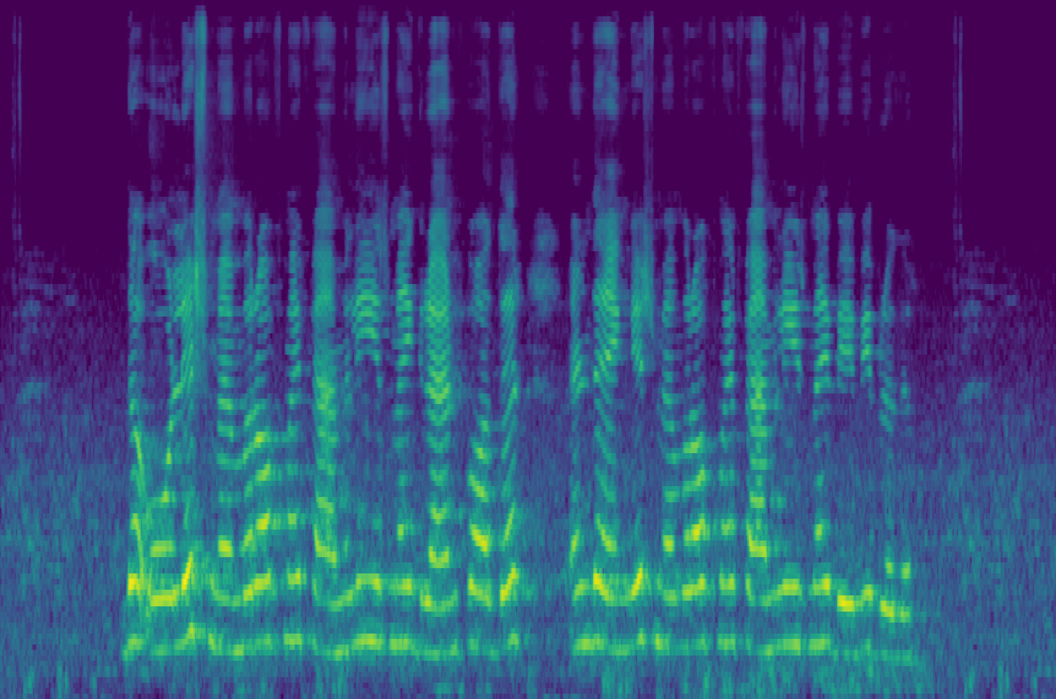
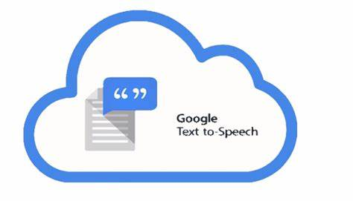


Methodology
server
Captured voice audio
Personalized speech
Text to Speech service
Hybrid CNN-RNN model
Saving speech pace
Speech pace module
Predicted speech rate
Database
IT21223594 | Thalangama T.P. | 24-25J-233

Slide 53
Model Architecture
CNN branch – VGG16
Multi-layer Feature Combination
Image Input
Convolutional Layers
Concatenate Feature
Feature Extraction layers
Final prediction layer
CNN Reduction Layer
Combine Layer 1
Combine Layer 2
Predicted speech pace
RNN branch –Wav2Vec 2.0
Audio Input
Combine Layer 3
Unfrozen Layers
Wav2Vec Reduction Layer
IT21223594 | Thalangama T.P. | 24-25J-233

Slide 54
Current progress
Overall completion – 60% ​
Completion of objectives​
Detect speech pace.
Hybrid model implementation – 100%.​
​
​
2. Analyzing voice features.
Hybrid model training – 75%.
​
​
3. Integrating detected speech pace with text to speech(TTS) service.
Hybrid model integration – 100%.​
TTS service integration – to be done.
​
4. System evaluation and validation.
To be done.​
IT21223594 | Thalangama T.P. | 24-25J-233

Slide 55
Current Progress
Overall completion – 96% ​
 | Progress Presentation I | Progress Presentation II
Hybrid model implementation | 100% | 100%
Hybrid model training | 75% | 100%
Hybrid model integration | 100% | 100%
TTS service integration | 100% | 100%
System evaluation and validation | 100% | 90%
Testing | 20% | 90%
IT21319174 | Dissanayake M.G.T.W | 24-25J-233

Slide 56
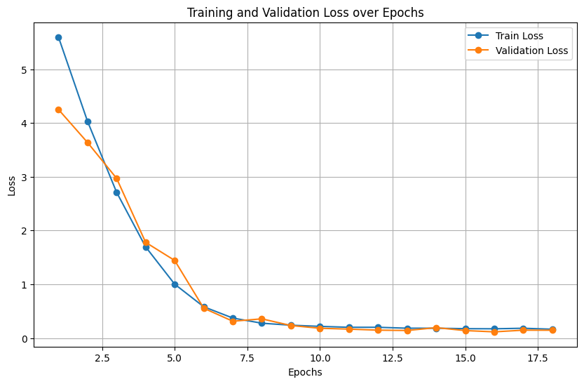
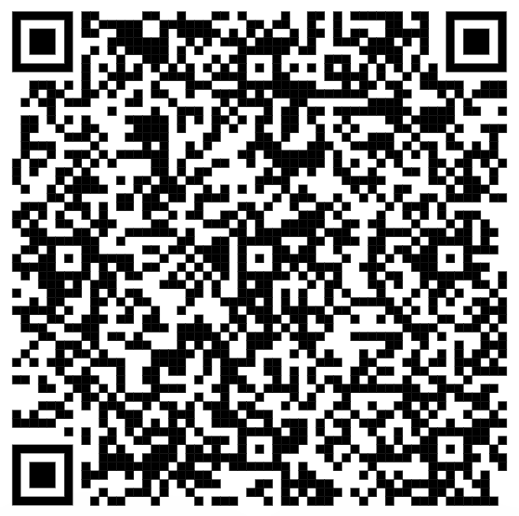
Evidence of Completion
Model Training Results
Dataset
Non-Native Children English Speech (NNCES) Corpus on Kaggle
Visit Dataset
IT21223594 | Thalangama T.P. | 24-25J-233

Slide 57
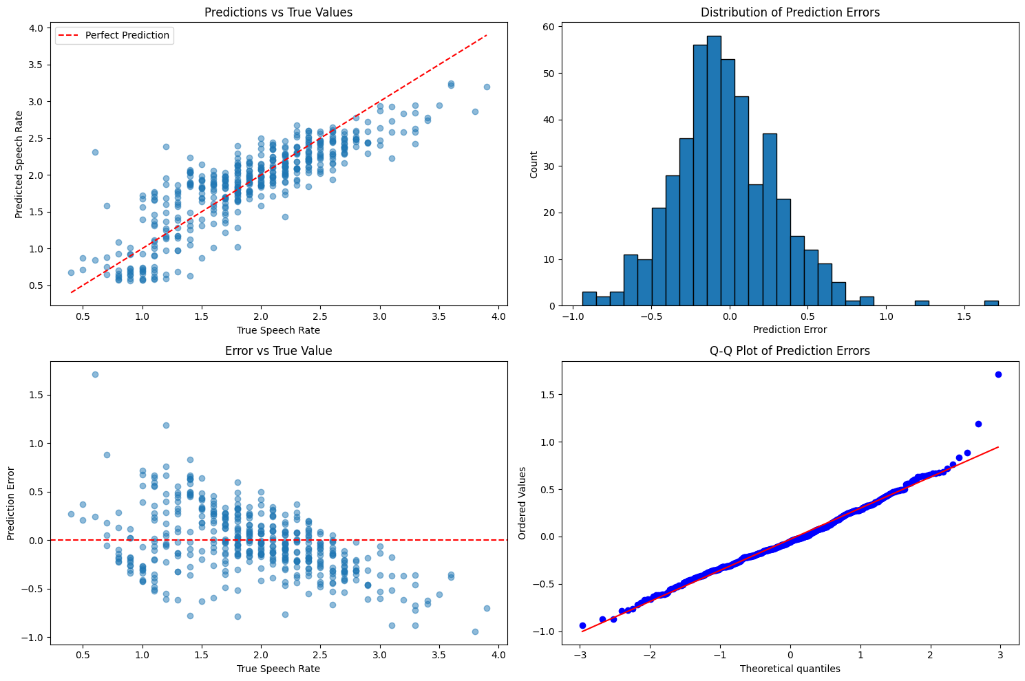
Evidence of Completion
Model Performance Metrics
IT21223594 | Thalangama T.P. | 24-25J-233

Slide 58
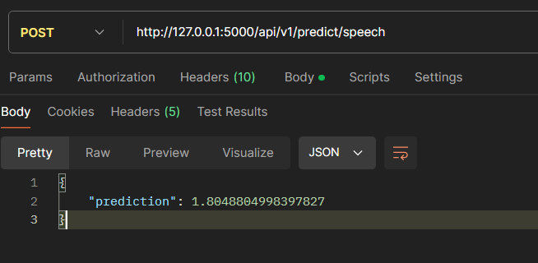
Evidence of Completion
Model Integration Testing – API Testing
IT21223594 | Thalangama T.P. | 24-25J-233

Slide 59
Risk Mitigation
Identified Risks & Mitigation Strategies
​
Poor model training caused by
unbalanced data.
Mitigated by mixing gathered training data
with Kaggle dataset.
​
Model Overfitting
Mitigated by adding regularization methods.
​
Data Storage & Privacy Concerns
Mitigated by immediately deleting data after
the prediction is completed.
IT21223594 | Thalangama T.P. | 24-25J-233

Slide 60
IT21318320 | Silva T.U.D
BSc (Hons) Degree in Information Technology (specialization in Software Engineering)

Slide 61
Teaching based on
Chromatic Variations
For Dyslexics
to improve Reading Skills
IT21318320 | Silva T.U.D | 24-25J-233

Slide 62
Overview
Dyslexia – Most common Learning Disability
Reading – Most common symptom
Existing Solutions
Nessy – User friendly mobile app
ClarroSpeak – Text highlighting enabled app
Research Gap
Why not a scientifically proven method?
Is all the same?
Solution with novelty
LexaAyudha
Chromatic Variation, Personalization, Web Application
IT21318320 | Silva T.U.D | 24-25J-233

Slide 63
Overview
Research Problem
Automating the generation of meaningful sentences with personalization capabilities.
Identifying suitable chromatic variation type complexity level.
Objectives
Identify the appropriate chromatic variation types and colors.
Sample test to identify the efficient color combinations.
Sample test to identify the most efficient chromatic variation type.
Provide a personalized activity plan.
Test to check the reading skills to customize the complexity levels of the tasks.
Create personalized reading task plans.
IT21318320 | Silva T.U.D | 24-25J-233

Slide 64
Requirements
Functional Requirements​
Create a personal account and access the application
Perform suited chromatic variation and color variation tests
View and learn personalized lessons
Perform quizzes and assess the performance
Non-Functional Requirements
Reliability
Accuracy
Security​ ​
System Requirements​
Stable internet connection.​
A microphone.​
Personal Requirements ​
Consent to provide speech audio data.​
Software Requirements
Web browser with microphone access.​ ​
IT21318320 | Silva T.U.D | 24-25J-233

Slide 65
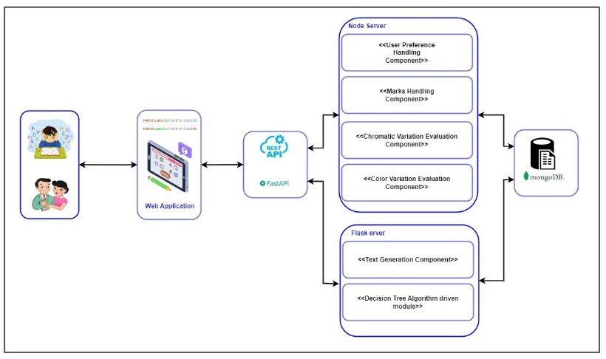
Methodology
IT21318320 | Silva T.U.D | 24-25J-233

Slide 66
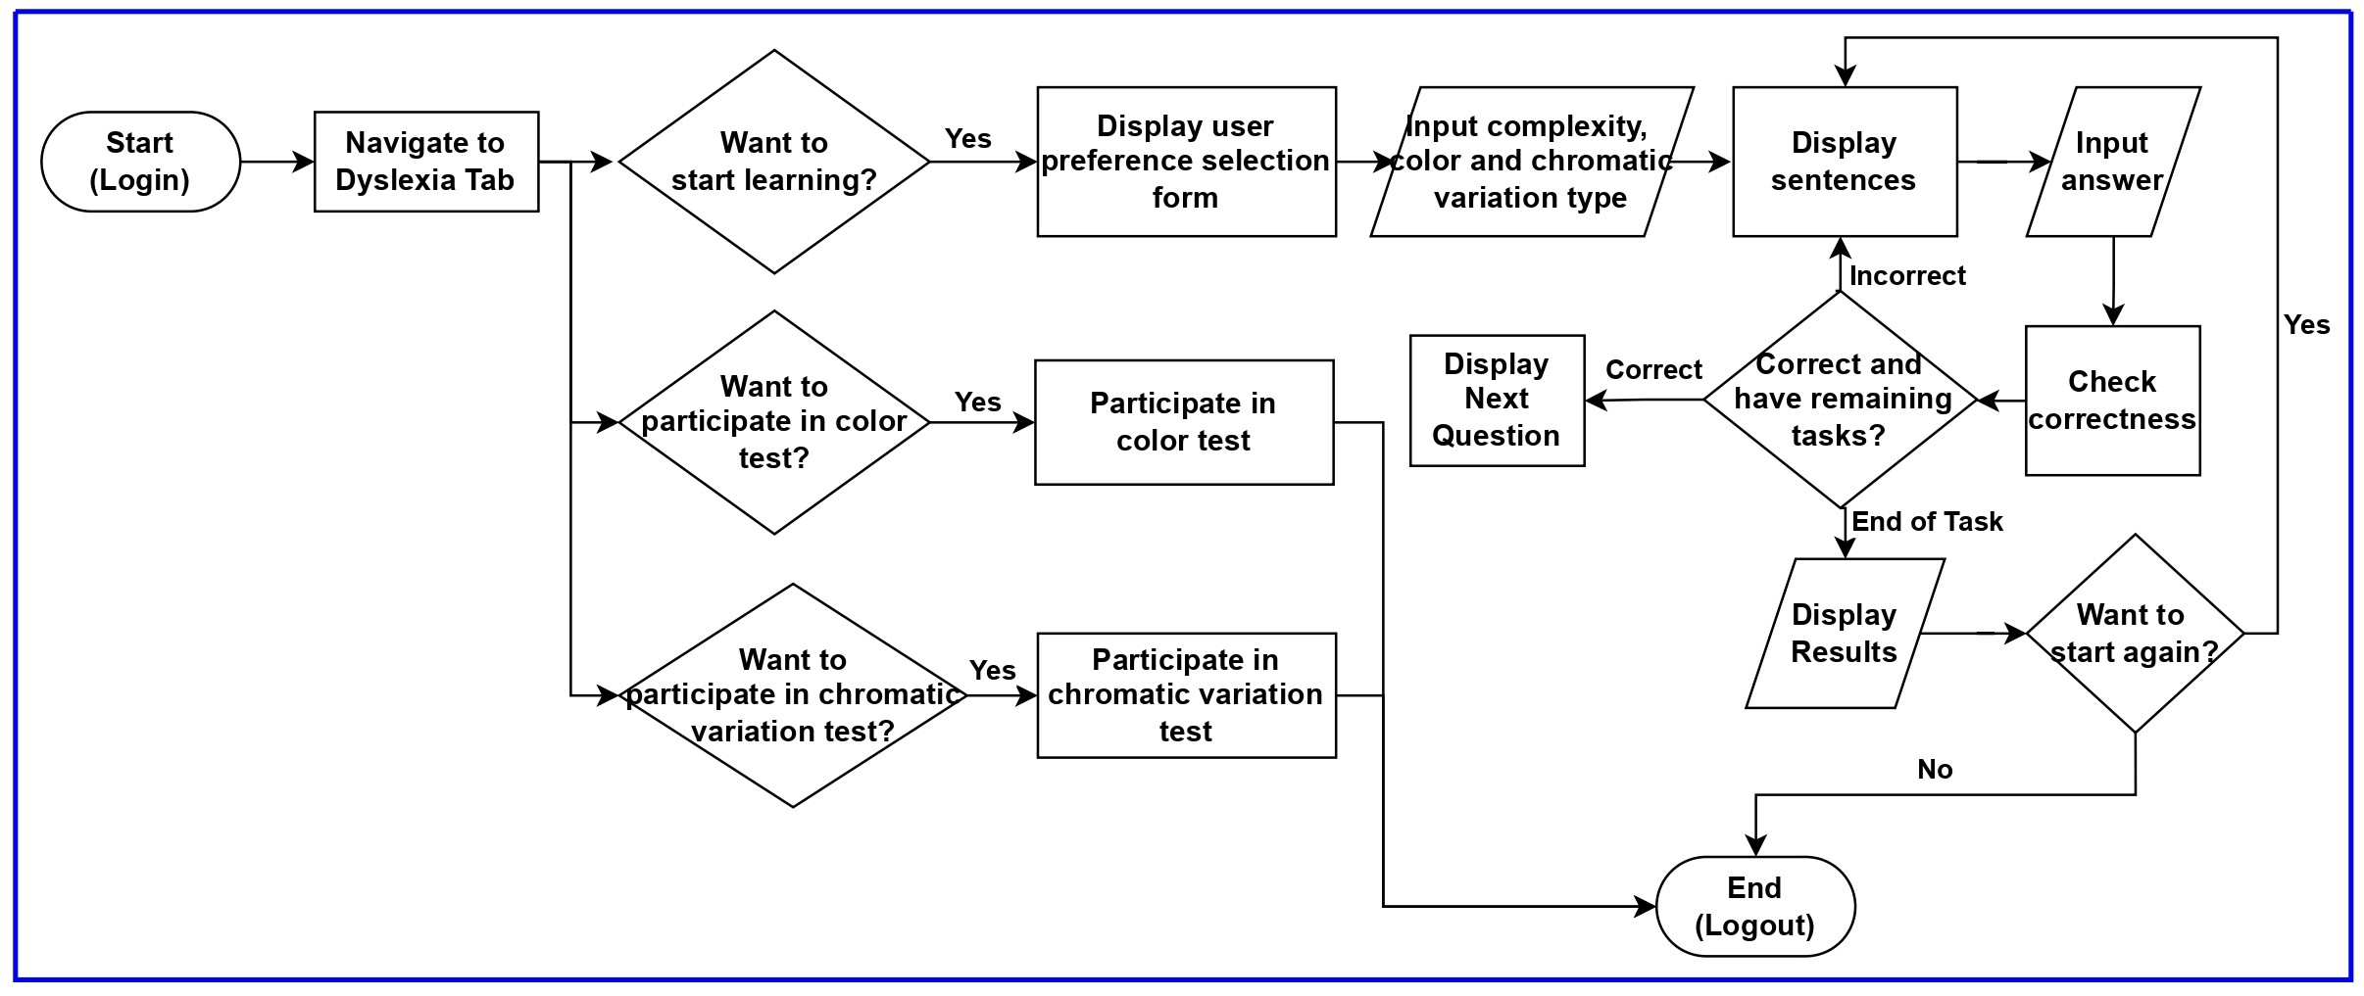
System Flow
IT21318320 | Silva T.U.D | 24-25J-233

Slide 67
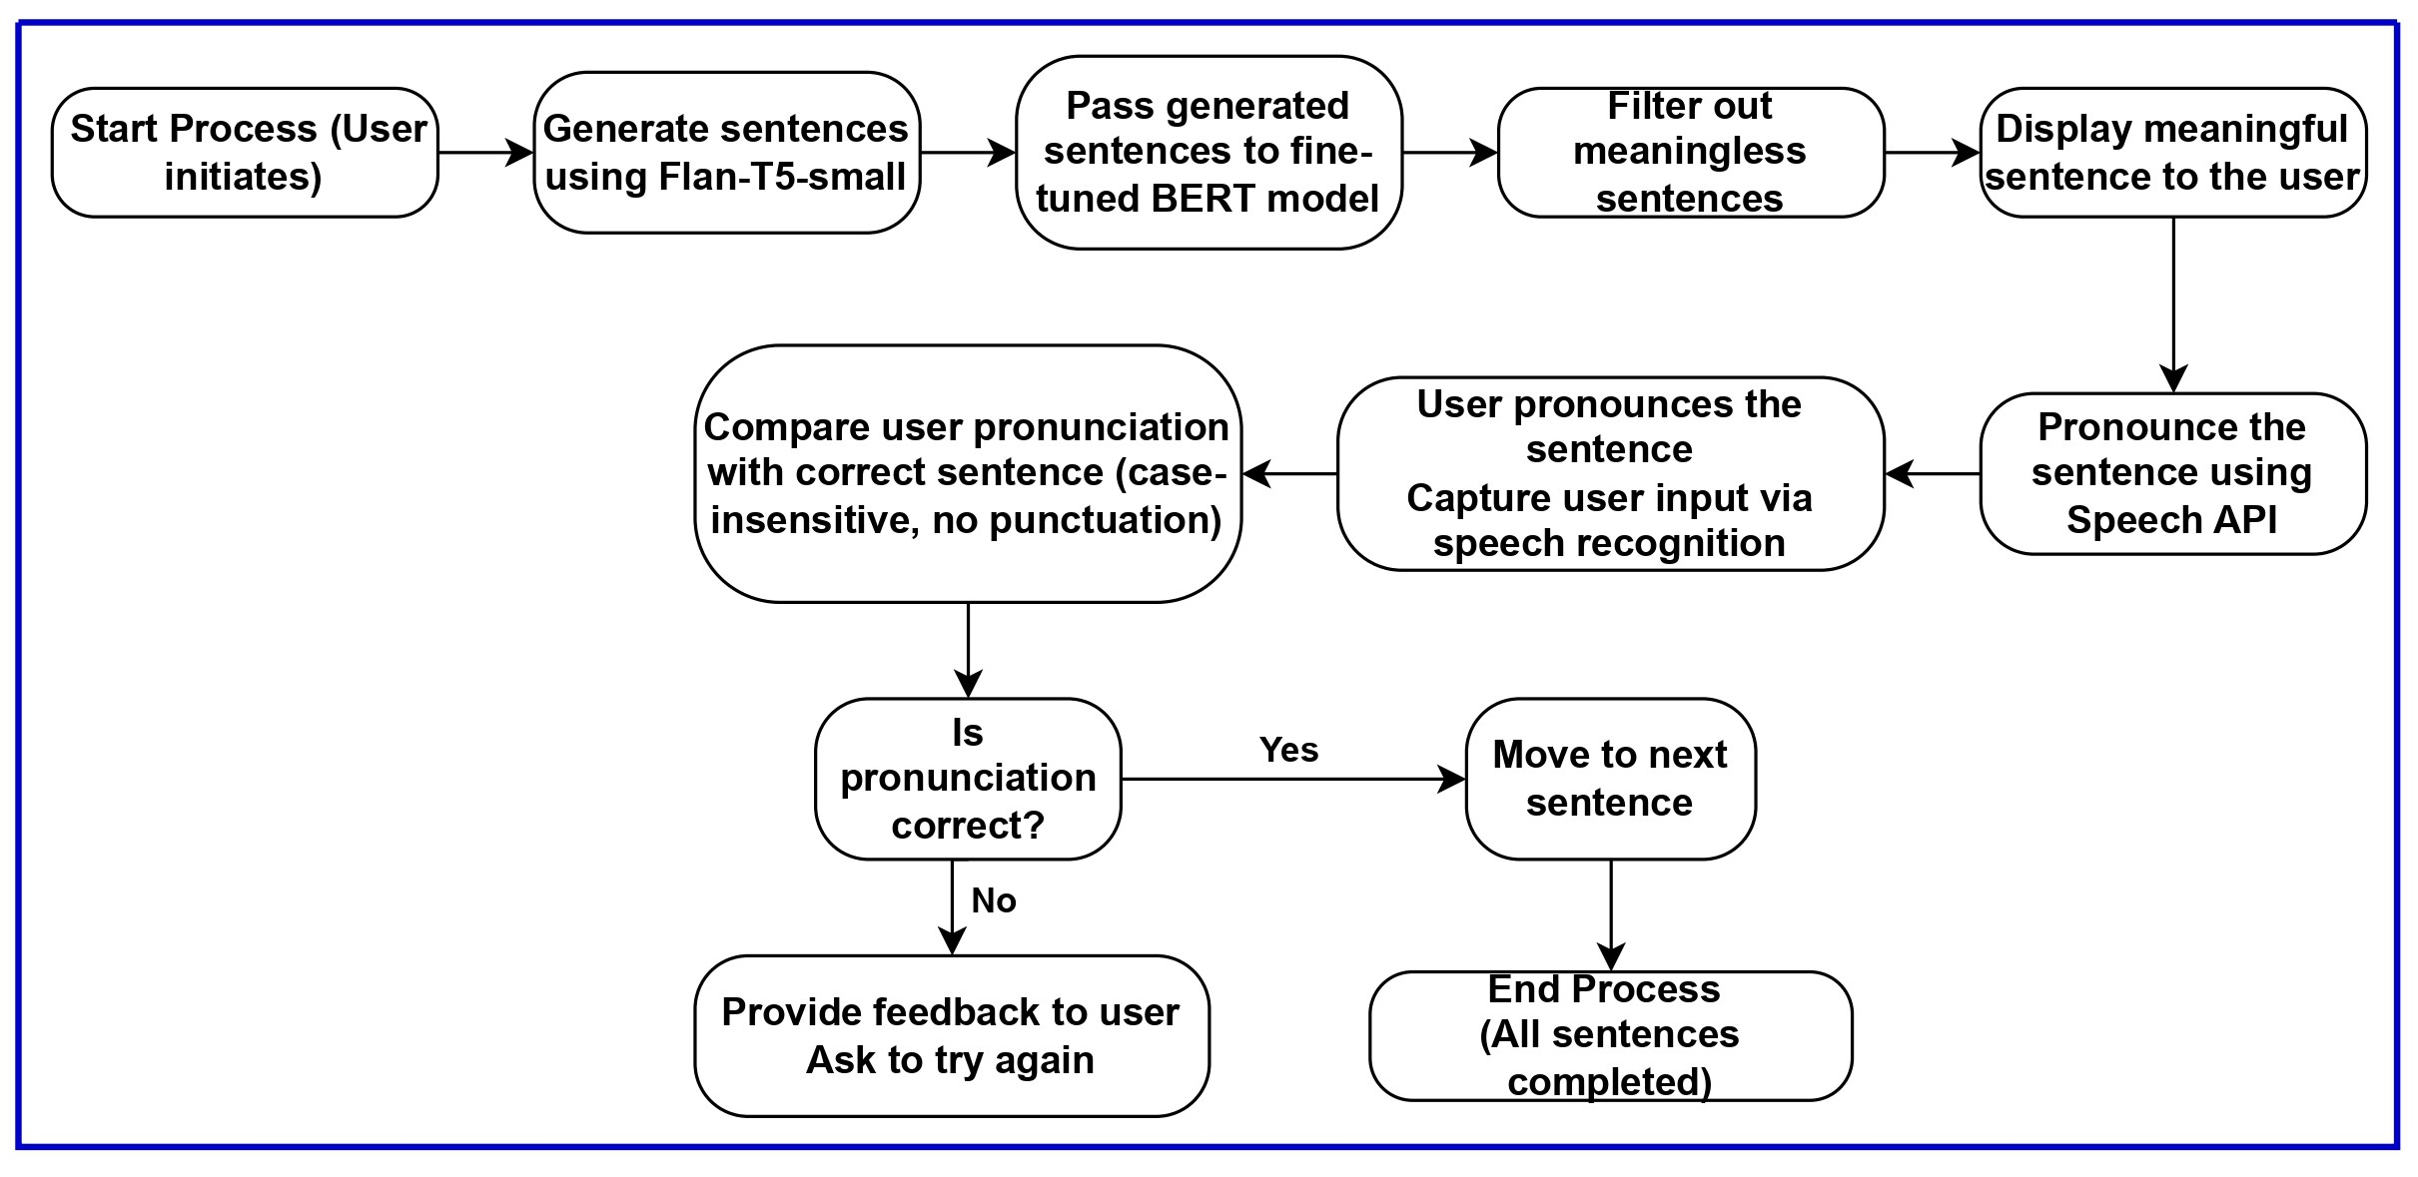
Current Progress
Overall completion – 95% ​​
IT21318320 | Silva T.U.D | 24-25J-233

Slide 68
Current Progress
Overall completion – 95% ​
 | Progress Presentation I | Progress Presentation II
Generate sentences with specified complexity | 100% | 100%
Check for meaning | 75% | 100%
Display only meaningful sentences | 75% | 100%
Present the sentences as a questionnaire | 80% | 100%
Pronounce the words | 90% | 100%
Check for accuracy | 50% | 100%
Dynamic questionnaire | 50% | 80%
Testing | 20% | 80%
IT21319174 | Dissanayake M.G.T.W | 24-25J-233

Slide 69
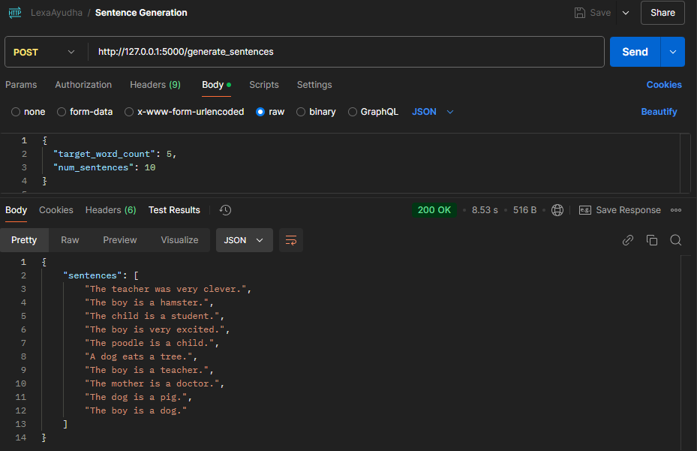
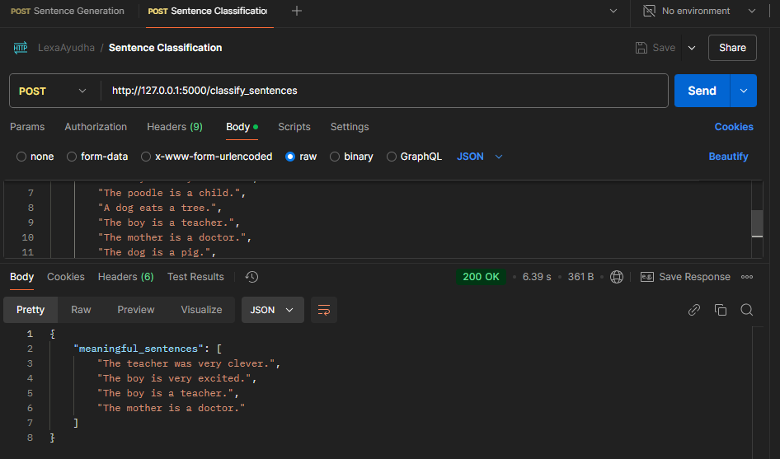
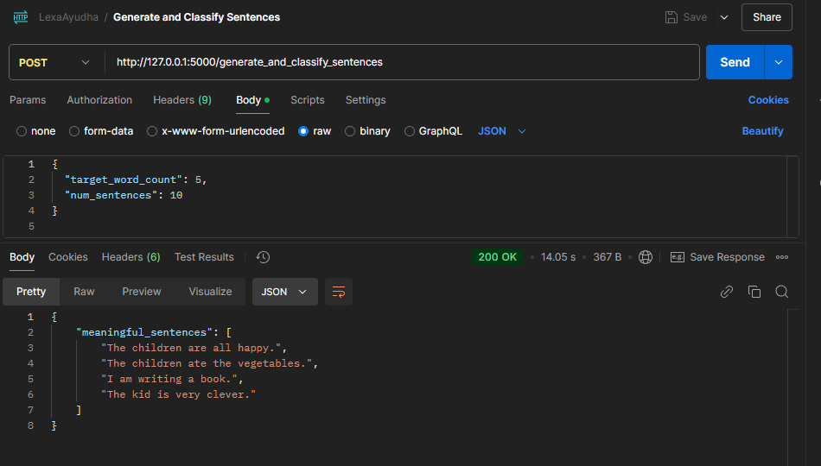
Evidence of Completion
IT21318320 | Silva T.U.D | 24-25J-233

Slide 70
Evidence of Completion
IT21318320 | Silva T.U.D | 24-25J-233

Slide 71
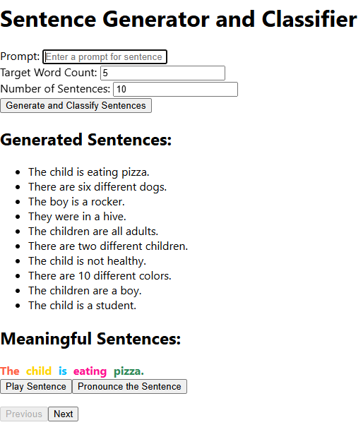
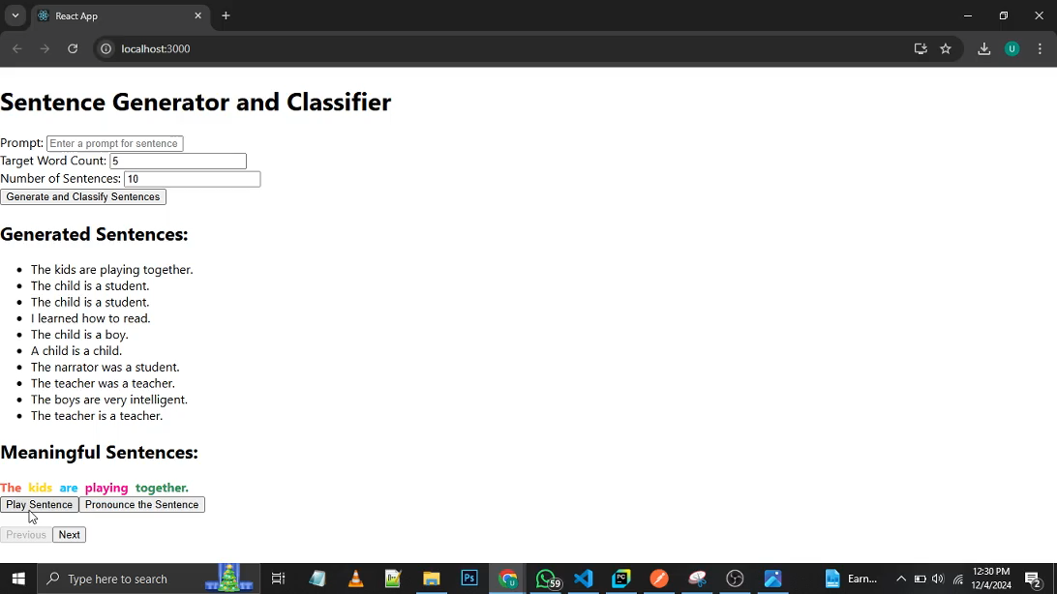
Evidence of Completion
IT21318320 | Silva T.U.D | 24-25J-233

Slide 72
Risk Mitigation
Identified Risks & Mitigation Strategies
​
Model performance Issues
Regular tests
Fine tuning the model periodically
Keep a default set of appropriate sentences.
​
Insufficient meaningful sentences
in the dataset
Increase the dataset with additional
labeled data.
​
Unauthorized access to the system could
lead to misuse
Implement authentication and authorization mechanisms to secure endpoints
​
Interface may not be
user-friendly or accessible
Conduct usability testing with diverse users and incorporate feedback
IT21318320 | Silva T.U.D | 24-25J-233

Slide 73
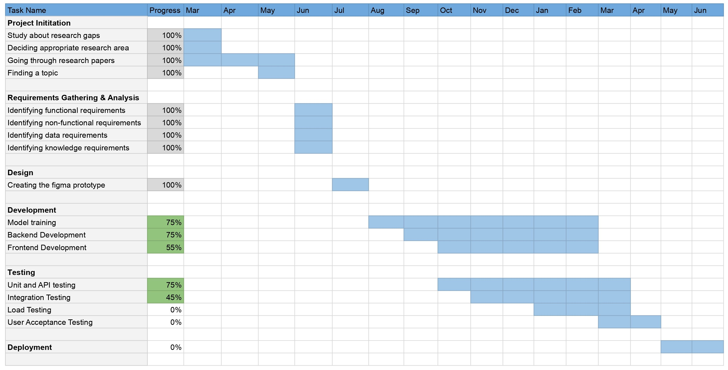
Future Direction
Fine tuning the model
Chromatic variation test
Color Test
IT21318320 | Silva T.U.D | 24-25J-233

Slide 74
Commercialization

Slide 75

Budget
Description | Cost
Vercel – Frontend Deployment | Free Tier
Render – Backend Deployment | Free Tier
Azure Cosmos DB | Free Tier(25GB Lifetime)
Azure Blob Storage | $0.018 per GB (First 5GB Free)
Mongo DB (Development)
Google speech to Text | 1 hour free for month | $0.006 per 15 seconds over 60 mins up to 1 million mins
Azure App Services – Application Deployment | Free Tier
Google Colab Pro | $9.99

Slide 76
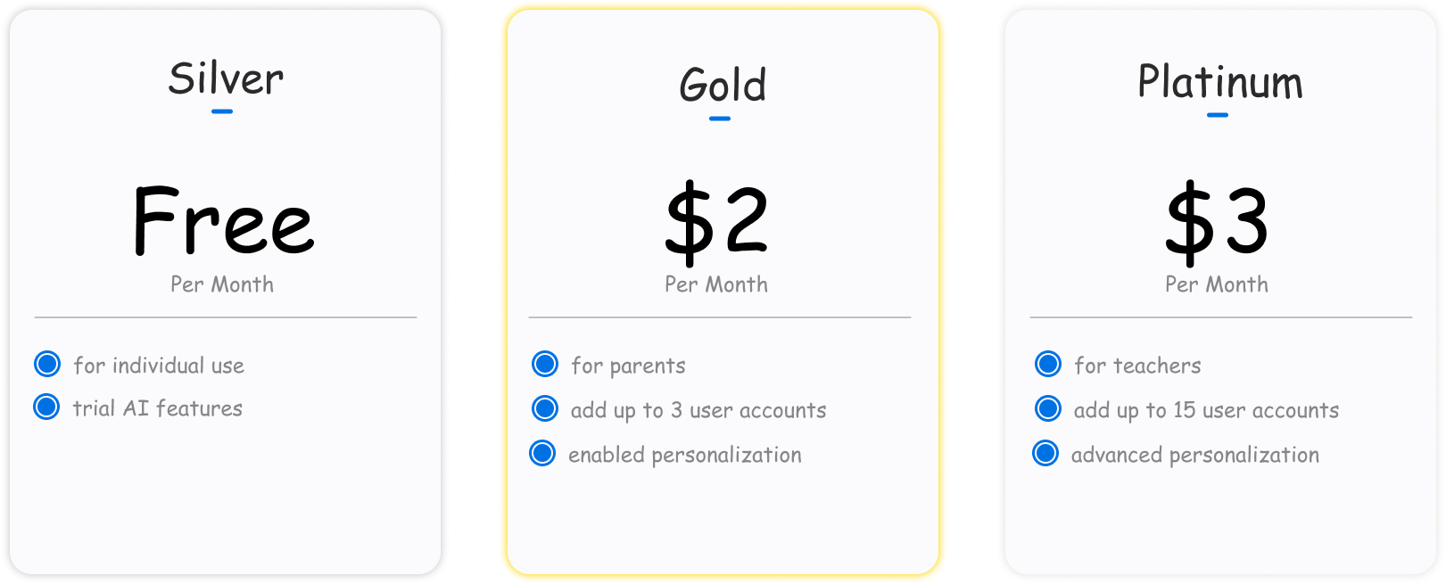
Monetizing Aspect
Subscription based business model
Donation enabled

Slide 77
User Benefits
Reduction in visual stress.
Increase in math confidence.
Market Viability
Target: Sri Lankan schools, global dyslexia/dyscalculia communities.
Revenue Model:
Subscription for schools.
Freemium for individuals.

Slide 78

Marketing Aspect
Primary Target Audience: The parents of learning divergent adolescents
Secondary Target Audience: Educators, Special education professionals
Digital Marketing
Social media marketing
Blogs
Email marketing
Partnerships
Collaboration with schools
Collaboration with dyslexic educational institutes

Slide 79
Future of LexAyudha

Slide 80
Impact
Revolutionizing personalized education for learning disabilities.
Next Steps
Multilingual support.
Mobile app development.

Slide 81
THANK YOU
AI-based Personalized Rehabilitation for Dyslexia and Dyscalculia Adolescents

Slide 82
Demo

Slide 83

ANY QUESTIONS?

